Slide 1
ShopSphere - A Complete E-Commerce SQL Engine
- Harshini P

Slide 2

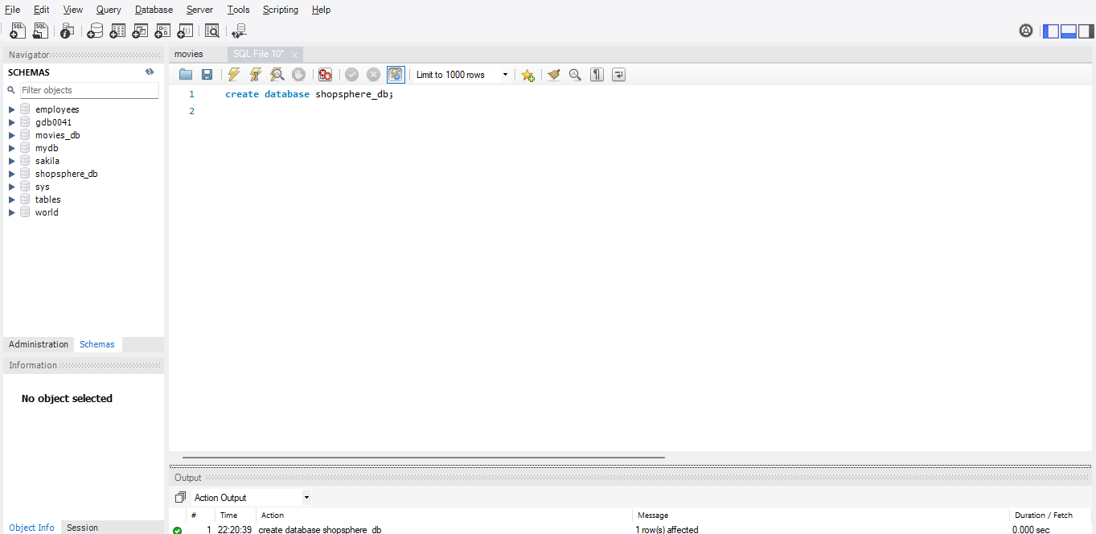
Create Database
To create the database, execute the query as
create database shopsphere_db;

Slide 3
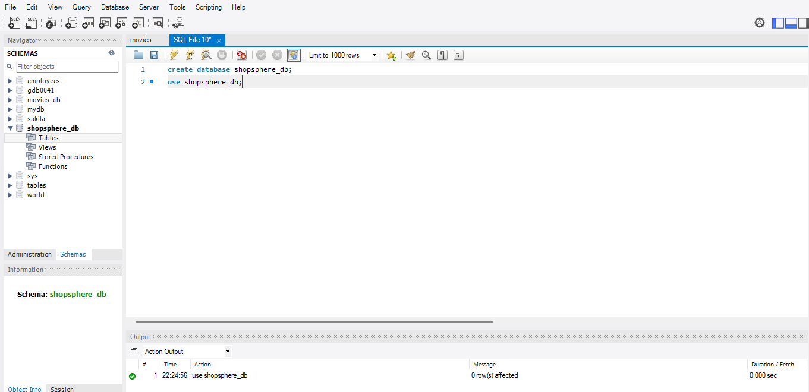
Use Database
To use the created database, execute the query as
use shopsphere_db;

Slide 4
Create Table
For the ShopSphere, planned to create ten tables based on the ecommerce:
- Customers
- Products
- Categories
- Sales Orders
- Invoices
- Shipments
- Credit Memos
- Reviews
- Newsletter Subscribers
- Wishlist
Queries used for creating tables are as follows:

Slide 5
Creating Table-1: Customers
To create the customers table under the database, execute the query as
create table Customers
(cust_id int primary key auto_increment,
cust_first_name varchar(30),
cust_last_name varchar(30),
cust_dob date,
cust_gender varchar(10),
cust_email varchar(30) unique key,
cust_phone varchar(10),
cust_street_address varchar(30),
cust_city varchar(30),
cust_state varchar(30),
cust_country varchar(30),
cust_zip varchar(10));

Slide 6
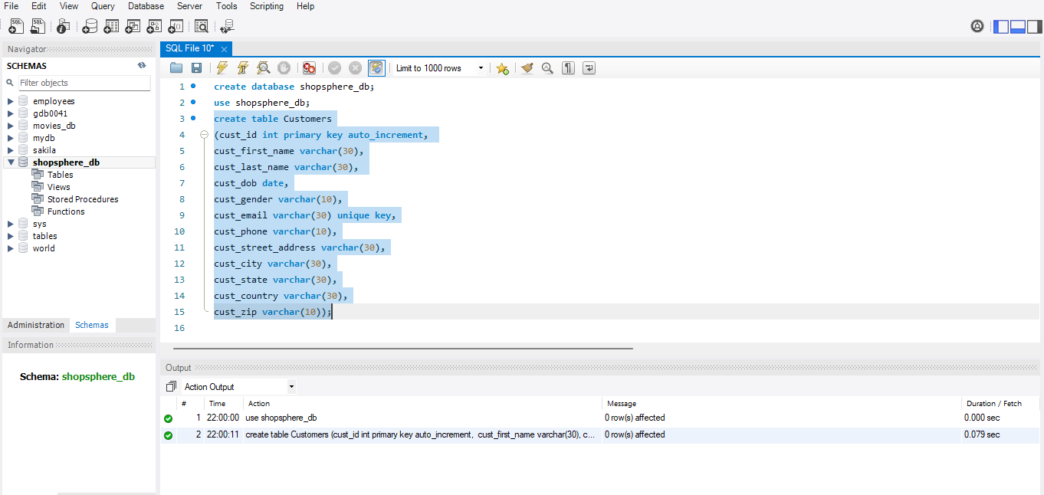
Created Customers Table
- Created the table by using the primary key, auto increment, unique key, with different data types
- Columns include the customer id, customer first name, customer last name, customer date of birth, customer gender, customer email, customer phone, customer street address, customer city, customer state, customer country and customer zip code.
- Here, the customer id is used as the primary key, because customer id should not be null values also used as auto increment to automatically generate the unique number when the new records are inserted
- Also, the customer email is used as the unique key, because the email must be unique.

Slide 7
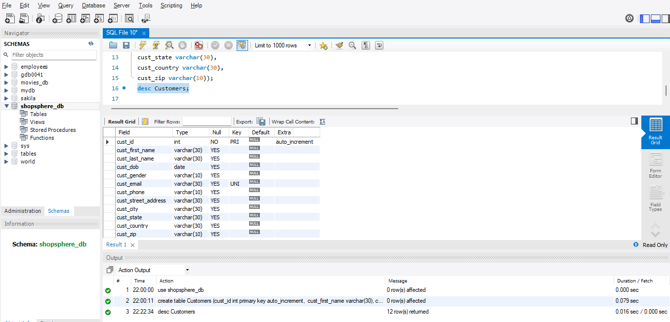
Describe Table
To describe the created table, executed the query as
desc Customers;

Slide 8
Inserting Values on Table 1: Customers
To insert ten values on the Customers table, executed the query as
INSERT INTO Customers
(cust_first_name, cust_last_name, cust_dob, cust_gender, cust_email, cust_phone, cust_street_address, cust_city, cust_state, cust_country, cust_zip)
VALUES
('Alice', 'Johnson', '1990-05-12', 'Female', 'alice.johnson@yopmail.com', '9876543210', '123 Main St', 'New York', 'NY', 'USA', '10001'),
('Bob', 'Smith', '1985-08-23', 'Male', 'bob.smith@yopmail.com', '9876543211', '456 Oak Ave', 'Los Angeles', 'CA', 'USA', '90001'),
('Charlie', 'Brown', '1992-12-15', 'Male', 'charlie.brown@yopmail.com', '9876543212', '789 Pine Rd', 'Chicago', 'IL', 'USA', '60601'),
('Diana', 'Prince', '1988-03-30', 'Female', 'diana.prince@yopmail.com', '9876543213', '321 Elm St', 'Houston', 'TX', 'USA', '77001'),
('Ethan', 'Hunt', '1979-11-20', 'Male', 'ethan.hunt@yopmail.com', '9876543214', '654 Cedar Ln', 'Phoenix', 'AZ', 'USA', '85001'),
('Fiona', 'Gallagher', '1993-07-10', 'Female', 'fiona.gallagher@yopmail.com', '9876543215', '147 Maple Dr', 'Philadelphia', 'PA', 'USA', '19101'),
('George', 'Martin', '1980-01-05', 'Male', 'george.martin@yopmail.com', '9876543216', '258 Birch Blvd', 'San Antonio', 'TX', 'USA', '78201'),
('Hannah', 'Lee', '1995-06-18', 'Female', 'hannah.lee@yopmail.com', '9876543217', '369 Willow Way', 'San Diego', 'CA', 'USA', '92101'),
('Ivan', 'Petrov', '1987-09-09', 'Male', 'ivan.petrov@yopmail.com', '9876543218', '753 Aspen Cir', 'Dallas', 'TX', 'USA', '75201'),
('Julia', 'Roberts', '1991-02-25', 'Female', 'julia.roberts@yopmail.com', '9876543219', '951 Poplar St', 'San Jose', 'CA', 'USA', '95101');

Slide 9
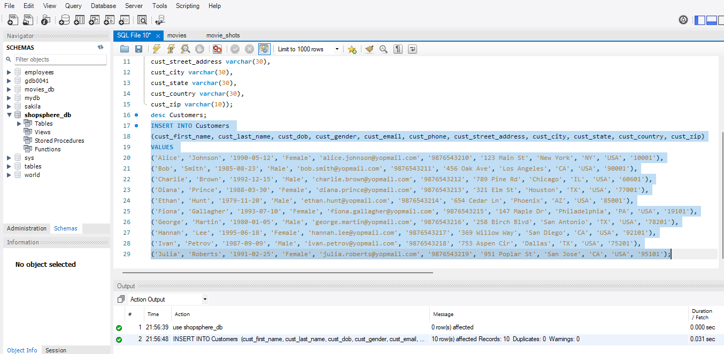
Inserted values on the Customers table
- Inserted ten values in the Customers table

Slide 10
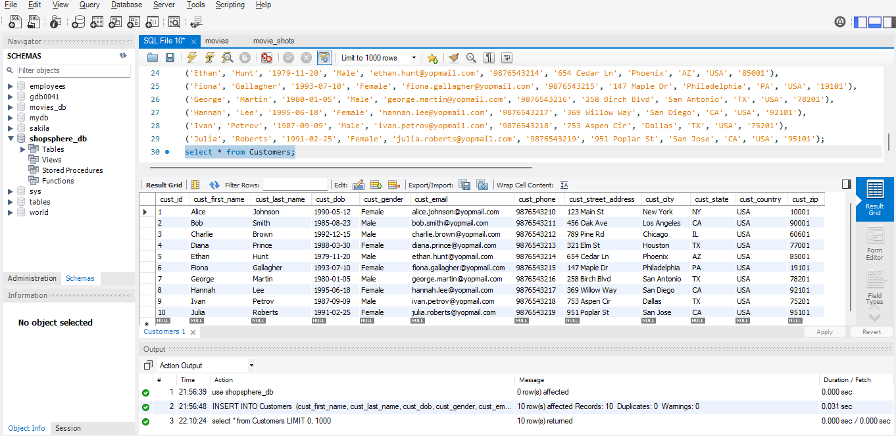
View all values in the Customers table
To view all the values in the Customers table, executed the query as
select * from Customers;

Slide 11
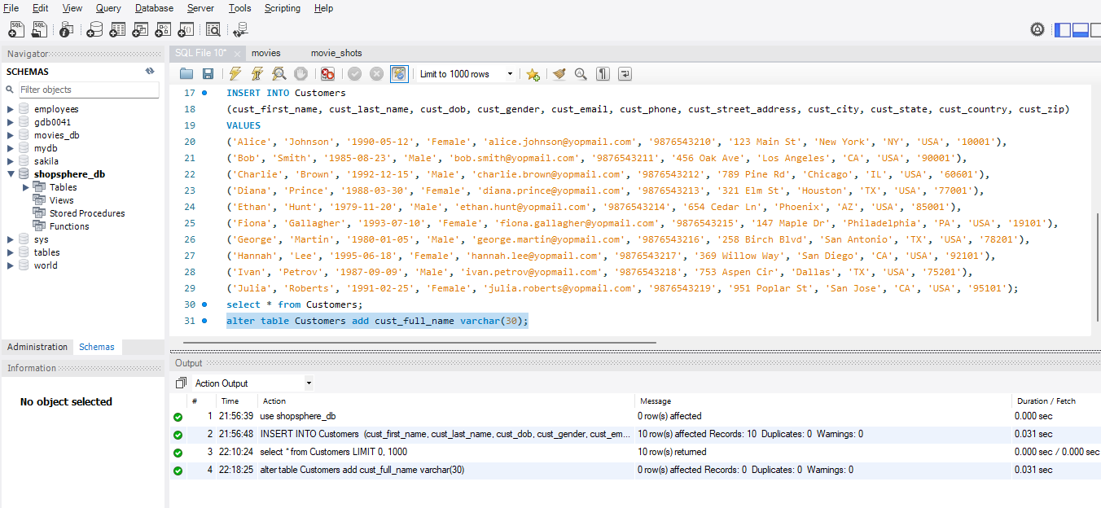
Alter column on the created table
To alter the column (added new column) on the created table, executed the query as
alter table Customers add cust_full_name varchar(30);

Slide 12
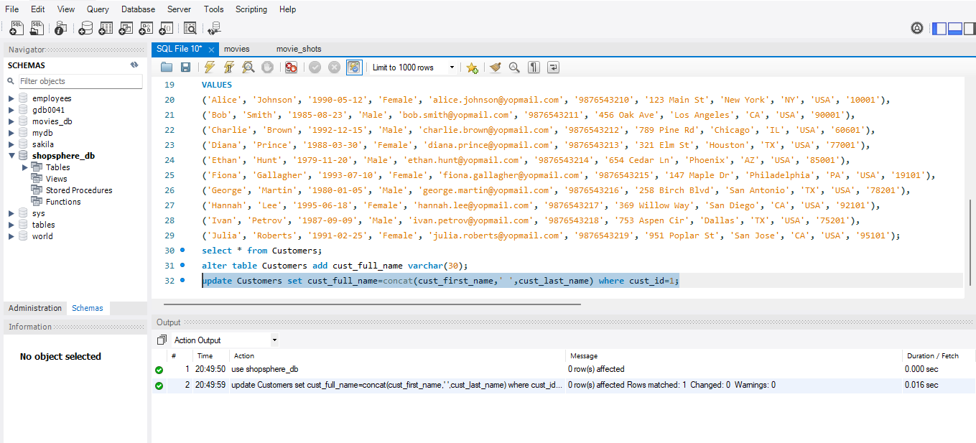
Updating values in the new column on the altered table
To update the values in the new column on the altered table, executed the query as
update Customers set cust_full_name=concat(cust_first_name,' ',cust_last_name) where cust_id=1;

Slide 13
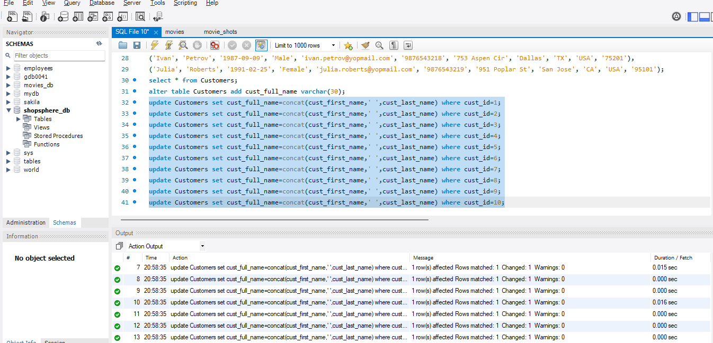
Updated values in the Customer Table
Updated ten values in the columns present in the customer table.

Slide 14
Creating Table - 2: Products
To create the products tables under the database, execute the query as
create table Products
(prod_id int primary key auto_increment,
prod_name varchar(30),
prod_type varchar(30),
prod_sku varchar(30) unique,
prod_price float,
prod_qty int,
prod_status varchar(30)
);

Slide 15
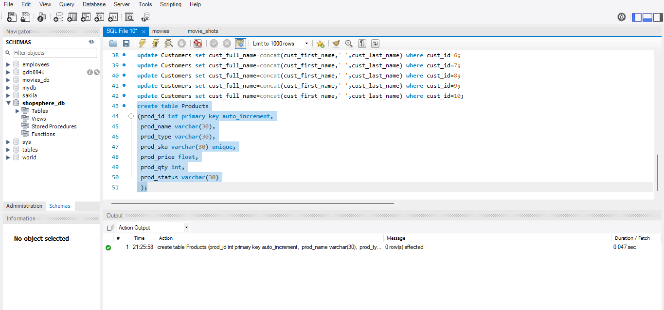
Created Products Table
- Created the table by using the primary key, auto increment, unique key, with different data types
- Columns include the product id, product name, product type, product sku, product price, product quantity, product status.
- Here, the product id is used as the primary key, because product id should not be null values also used as auto increment to automatically generate the unique number when the new records are inserted
- Also, the product sku is used as the unique key, because the sku must be unique.

Slide 16
Inserting Values on Table 2: Products
To insert ten values on the Customers table, executed the query as
insert into Products
(prod_name,prod_type,prod_sku,prod_price,prod_qty,prod_status)
Values
('Wireless Mouse', 'Electronics', 'SKU001', 19.99, 150, 'Available'),
('Bluetooth Speaker', 'Electronics', 'SKU002', 49.99, 75, 'Available'),
('Running Shoes', 'Footwear', 'SKU003', 89.50, 120, 'Available'),
('Notebook', 'Stationery', 'SKU004', 2.99, 500, 'Available'),
('Gaming Keyboard', 'Electronics', 'SKU005', 69.99, 40, 'Available'),
('Backpack', 'Accessories', 'SKU006', 39.99, 80, 'Available'),
('Water Bottle', 'Home & Kitchen', 'SKU007', 9.99, 200, 'Available'),
('LED Monitor', 'Electronics', 'SKU008', 129.99, 30, 'Available'),
('Office Chair', 'Furniture', 'SKU009', 149.99, 25, 'Available'),
('Sunglasses', 'Accessories', 'SKU010', 24.99, 100, 'Available');

Slide 17
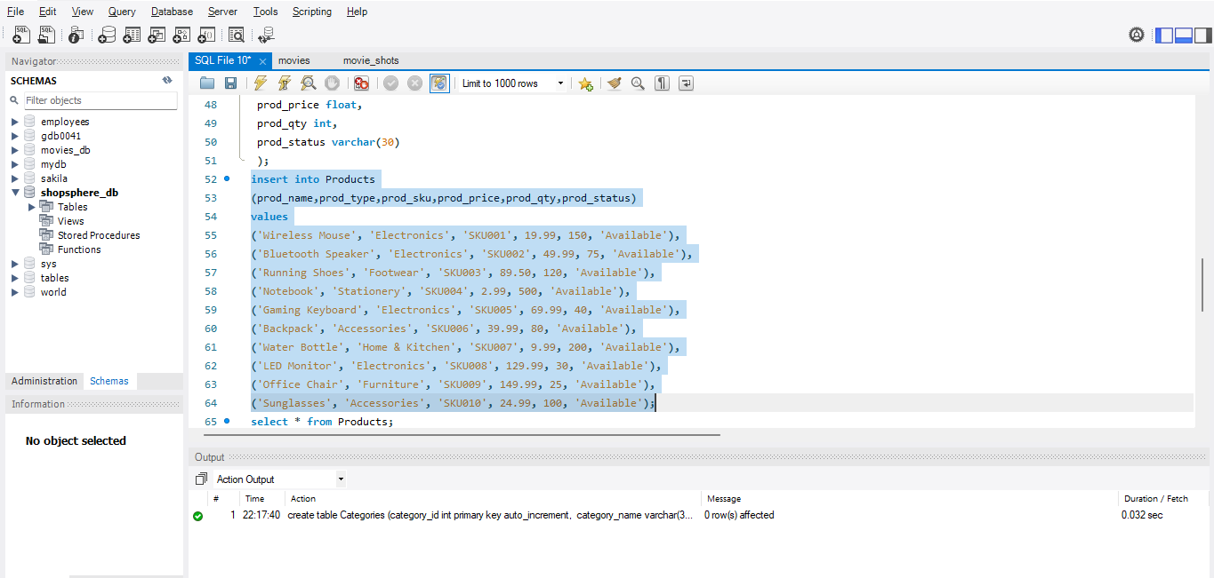
Inserted values on the Products table
- Inserted ten values in the Products table

Slide 18
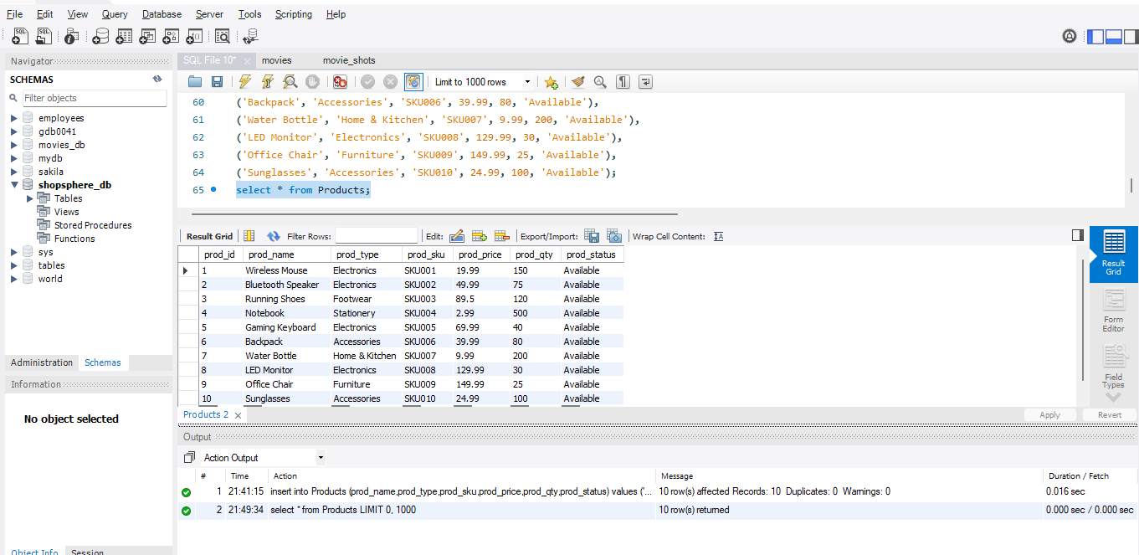
View all values in the Products table
To view all the values in the Products table, executed the query as
select * from Products;

Slide 19
Creating Table - 3: Categories
To create the categories table under the database, execute the query as
create table Categories
(category_id int primary key auto_increment,
category_name varchar(30) unique,
category_status varchar(20),
include_in_menu varchar(10),
category_description text,
products_in_category int default 0 );

Slide 20
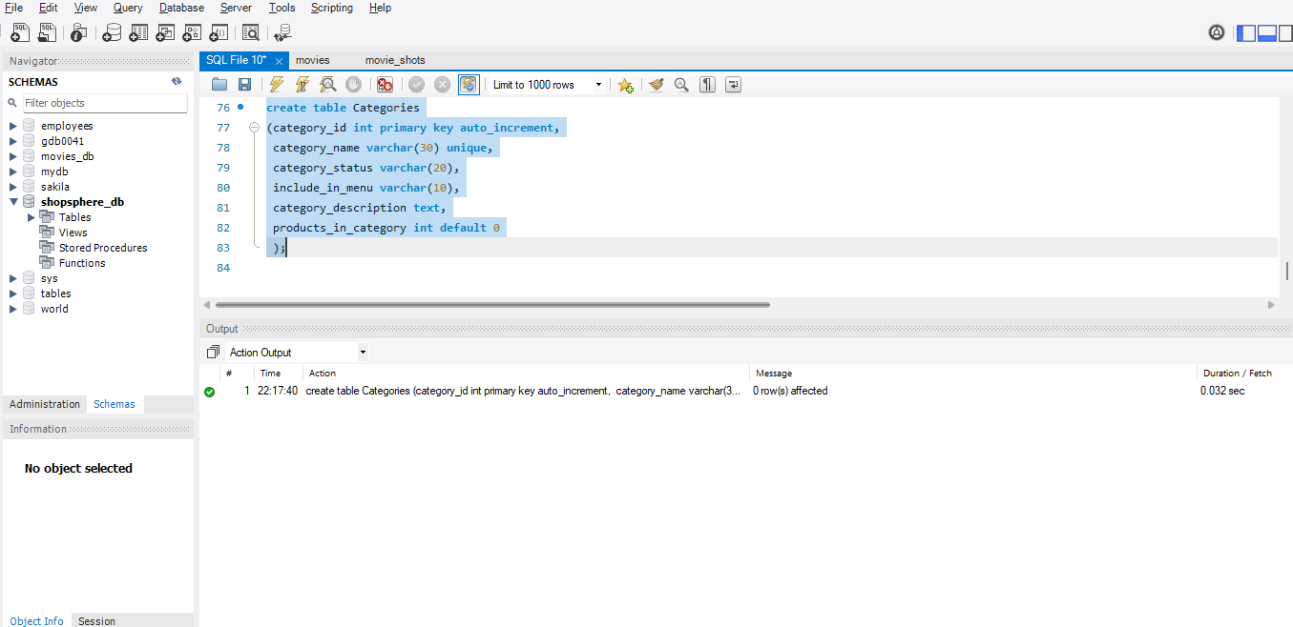
Created Categories Table
- Created the table by using the primary key, auto increment, unique key, default key with different data types
- Columns include the catgory id, category name, category status, include in menu, category description, and products in category
- Here, the category id is used as the primary key, because category id should not be null values also used as auto increment to automatically generate the unique number when the new records are inserted
- Also, the category name is used as the unique key, because the category name must be unique, and also used the default key on the products in category, which is set to be 0, if no values are given.

Slide 21
Inserting Values on Table 3: Categories
To insert ten values on the Categories table, executed the query as
insert into Categories
(category_name, category_status, include_in_menu, category_description, products_in_category)
VALUES
('Electronics', 'Active', TRUE, 'Devices and gadgets including phones, laptops, and accessories.', 150),
('Footwear', 'Active', TRUE, 'Men\'s and women\'s shoes, sandals, and sports footwear.', 80),
('Furniture', 'Active', TRUE, 'Chairs, tables, beds, and other household furniture items.', 40),
('Accessories', 'Active', TRUE, 'Fashion accessories like bags, watches, and sunglasses.', 70),
('Stationery', 'Active', TRUE, 'Office and school supplies including notebooks and pens.', 200),
('Home & Kitchen', 'Active', TRUE, 'Home essentials and kitchen tools for daily use.', 120),
('Gaming', 'Active', TRUE, 'Gaming consoles, accessories, and gear.', 55),
('Books', 'Inactive', FALSE, 'Wide range of fiction, non-fiction, and educational books.', 0),
('Health & Beauty', 'Active', TRUE, 'Skincare, wellness, and health products.', 95),
('Toys & Baby', 'Active', TRUE, 'Toys, games, and baby care essentials.', 60);

Slide 22
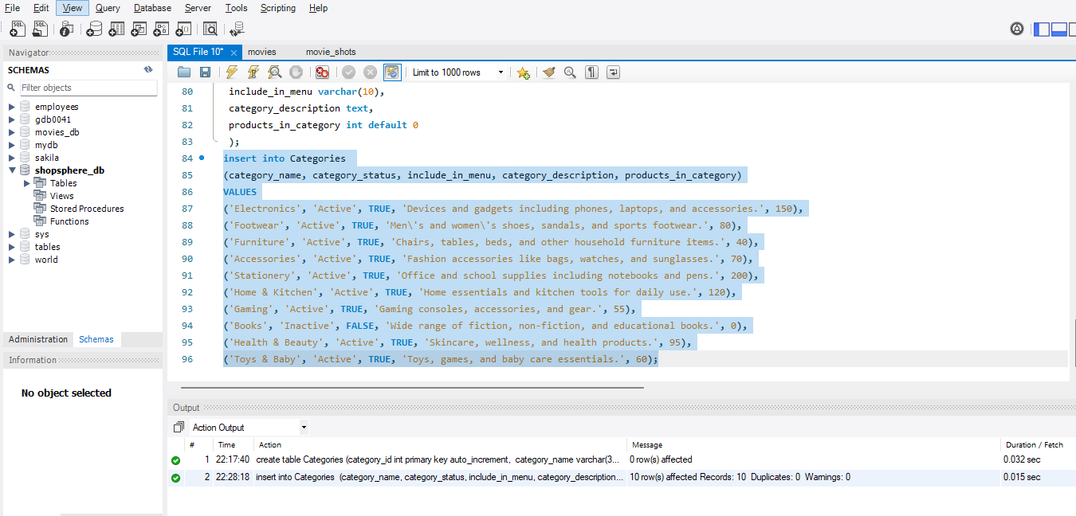
Inserted values on the Categories table
- Inserted ten values in the Categories table

Slide 23
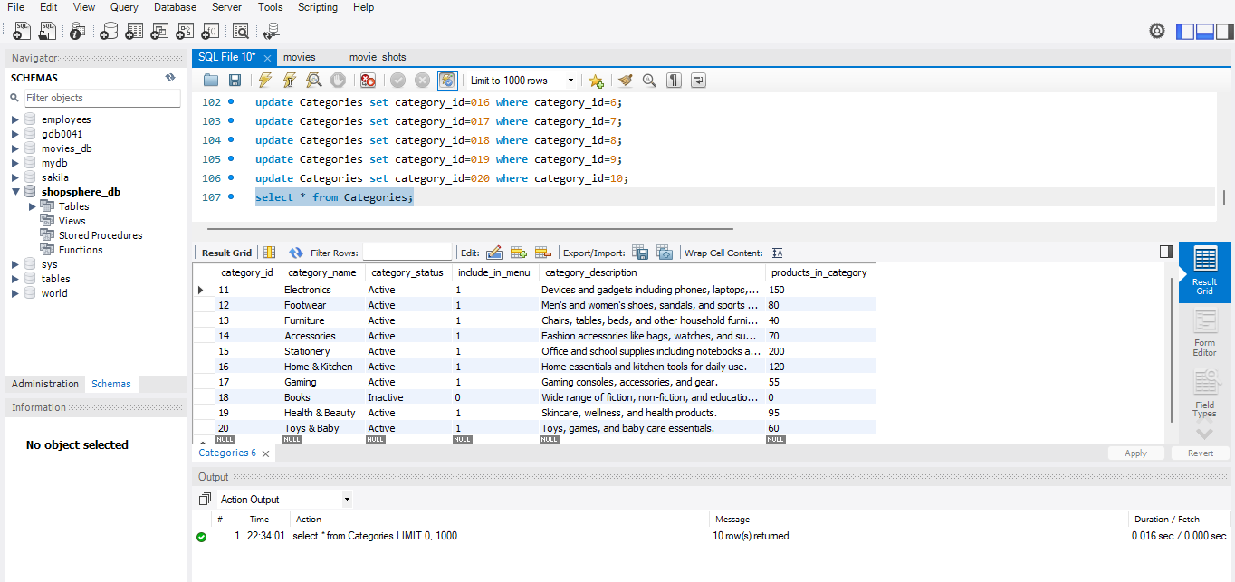
View all values in the Categories table
To view all the values in the Categories table, executed the query as
select * from Categories;

Slide 24
Creating Table - 4: Sales Order
To create the sales order table under the database, execute the query as
create table SalesOrder
(order_id int primary key auto_increment,
purchase_date datetime,
bill_to_name varchar(30),
ship_to_name varchar(30),
grand_total float,
order_status varchar(30),
billing_address text,
shipping_address text,
shipping_method varchar(30),
customer_email varchar(30),
subtotal float,
shipping_amount float,
customer_name varchar(30),
payment_method varchar(30),
total_refund float default 0.00);

Slide 25
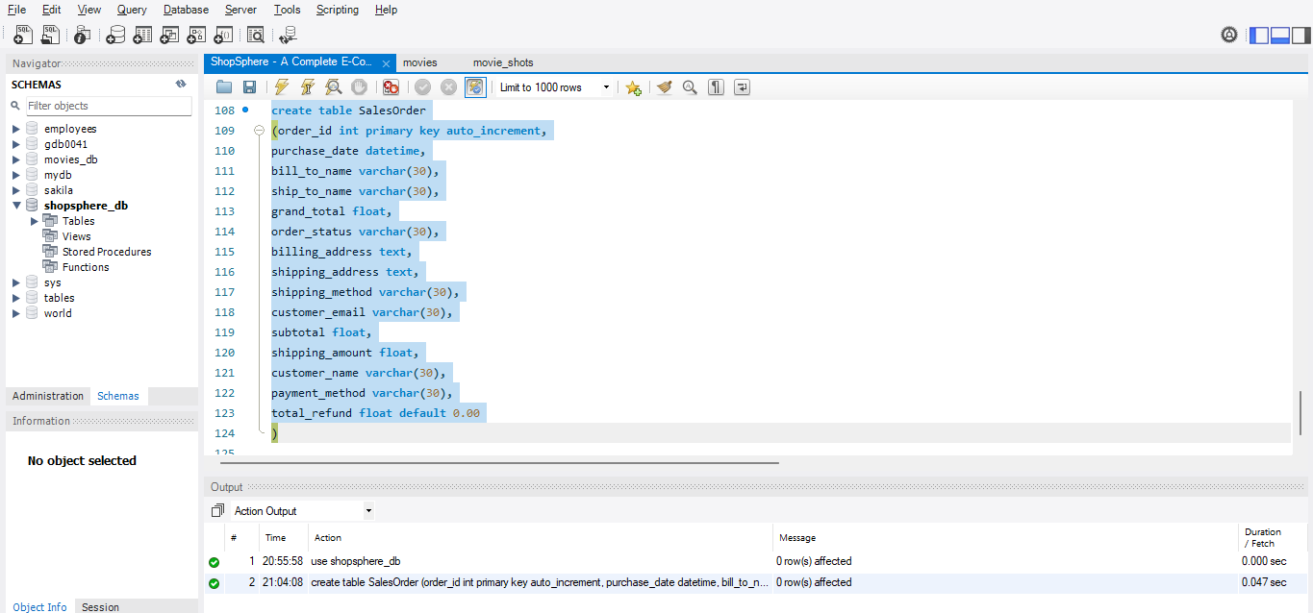
Created Sales Order Table
- Created the table by using the primary key, auto increment, default key with different data types
- Columns include the order id, purchase date, bill to name, ship to name, grand total, order status, billing address, shipping address, shipping method, customer email, subtotal, shipping amount, customer name, payment method, total refund.
- Here, the order id is used as the primary key, because order id should not be null values also used as auto increment to automatically generate the unique number when the new records are inserted
- Also, the default key is used on the total refund to set 0.00, if no values are given.

Slide 26
Inserting Values on Table 4: Sales Order
To insert ten values on the Sales Order table, executed the query as
insert into SalesOrder
(purchase_date, bill_to_name, ship_to_name, grand_total, order_status,billing_address, shipping_address, shipping_method, customer_email, subtotal, shipping_amount, customer_name, payment_method, total_refund)
Values
('2025-04-01 10:15:00', 'Alice Johnson', 'Alice Johnson', 79.99, 'Completed', '123 Main St, New York, NY', '123 Main St, New York, NY', 'Standard Shipping','alice.johnson@example.com', 69.99, 10.00, 'Alice Johnson', 'Credit Card', 0.00),
('2025-04-02 14:30:00', 'Bob Smith', 'Bob Smith', 49.99, 'Shipped', '456 Oak Ave, Los Angeles, CA', '456 Oak Ave, Los Angeles, CA', 'Express Shipping','bob.smith@example.com', 45.99, 4.00, 'Bob Smith', 'PayPal', 0.00),
('2025-04-03 09:00:00', 'Charlie Brown', 'Lucy Van Pelt', 109.50, 'Pending','789 Pine Rd, Chicago, IL', '321 Elm St, Houston, TX', 'Standard Shipping','charlie.brown@example.com', 99.50, 10.00, 'Charlie Brown', 'Credit Card', 0.00),
('2025-04-04 16:20:00', 'Diana Prince', 'Diana Prince', 129.99, 'Completed', '321 Elm St, Houston, TX', '321 Elm St, Houston, TX', 'Standard Shipping','diana.prince@example.com', 119.99, 10.00, 'Diana Prince', 'Credit Card', 0.00),
('2025-04-05 11:45:00', 'Ethan Hunt', 'Benji Dunn', 159.99, 'Shipped','654 Cedar Ln, Phoenix, AZ', '789 Willow Way, San Diego, CA', 'Express Shipping','ethan.hunt@example.com', 149.99, 10.00, 'Ethan Hunt', 'Credit Card', 0.00),
('2025-04-06 13:10:00', 'Fiona Gallagher', 'Fiona Gallagher', 39.99, 'Completed','147 Maple Dr, Philadelphia, PA', '147 Maple Dr, Philadelphia, PA', 'Standard Shipping','fiona.gallagher@example.com', 35.99, 4.00, 'Fiona Gallagher', 'Debit Card', 0.00),
('2025-04-07 08:00:00', 'George Martin', 'George Martin', 289.99, 'Completed','258 Birch Blvd, San Antonio, TX', '258 Birch Blvd, San Antonio, TX', 'Standard Shipping','george.martin@example.com', 279.99, 10.00, 'George Martin', 'Credit Card', 0.00),
('2025-04-08 15:45:00', 'Hannah Lee', 'Hannah Lee', 64.99, 'Pending','369 Willow Way, San Diego, CA', '369 Willow Way, San Diego, CA', 'Standard Shipping','hannah.lee@example.com', 59.99, 5.00, 'Hannah Lee', 'PayPal', 0.00),
('2025-04-09 17:25:00', 'Ivan Petrov', 'Ivan Petrov', 99.99, 'Completed','753 Aspen Cir, Dallas, TX', '753 Aspen Cir, Dallas, TX', 'Express Shipping','ivan.petrov@example.com', 89.99, 10.00, 'Ivan Petrov', 'Credit Card', 5.00),
('2025-04-10 12:50:00', 'Julia Roberts', 'Julia Roberts', 79.50, 'Refunded', '951 Poplar St, San Jose, CA', '951 Poplar St, San Jose, CA', 'Standard Shipping','julia.roberts@example.com', 69.50, 10.00, 'Julia Roberts', 'Credit Card', 79.50);

Slide 27
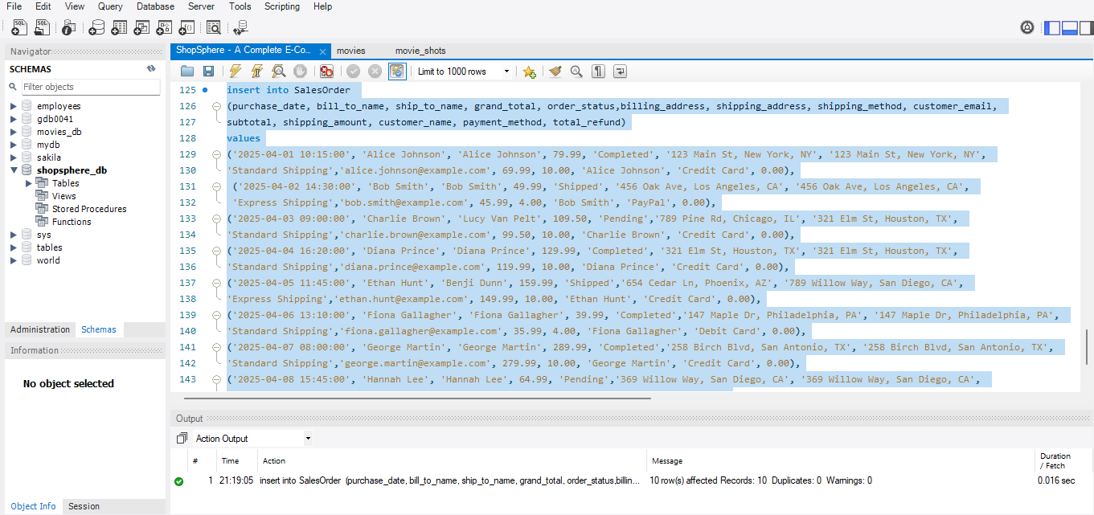
Inserted values on the Sales Order table
- Inserted ten values in the Sales Order table

Slide 28
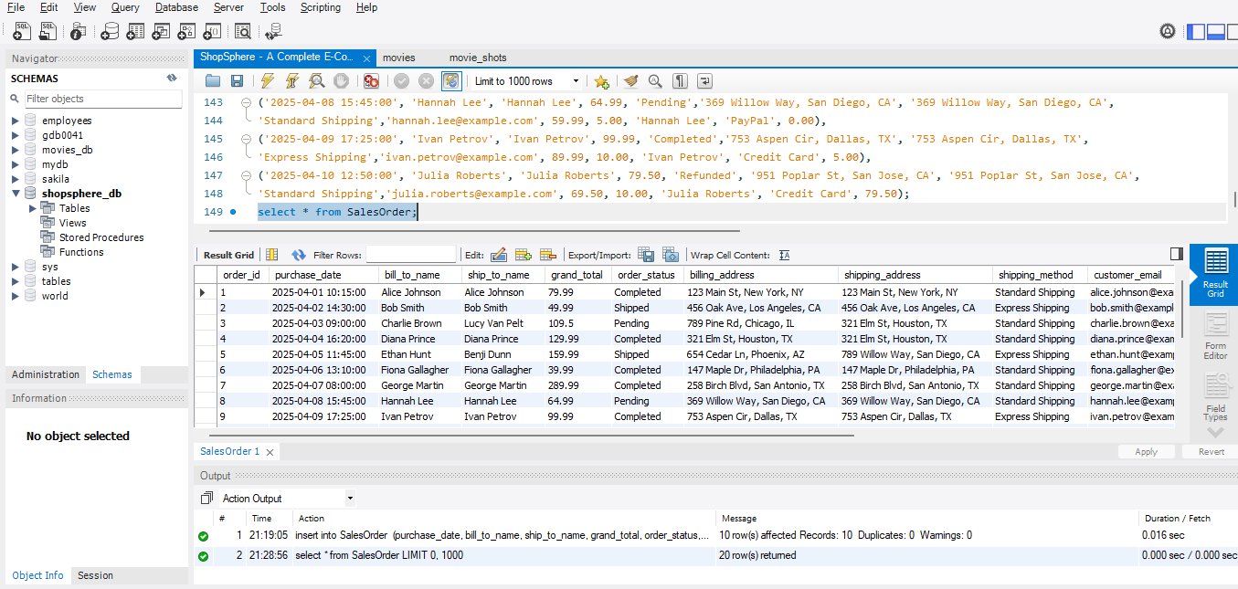
View all values in the Sales Order table
To view all the values in the Sales Order table, executed the query as
select * from SalesOrder;

Slide 29
Creating Table - 5: Invoices
To create the Invoices table under the database, execute the query as
create table Invoices
(invoice_id int primary key auto_increment,
invoice_date datetime,
order_id int,
bill_to_name varchar(30),
invoice_status varchar(30),
grand_total float,
billing_address text,
shipping_address text,
customer_name varchar(30),
customer_email varchar(30),
payment_method varchar(30),
shipping_method varchar(30),
subtotal float,
shipping_amount float,
foreign key (order_id) references SalesOrder(order_id));

Slide 30
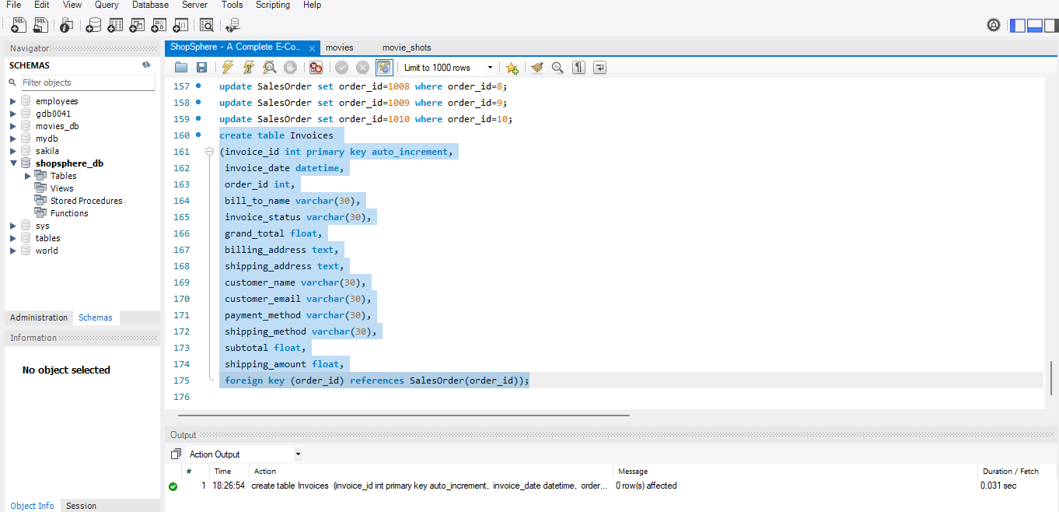
Created Invoices Table
- Created the table by using the primary key, auto increment, foreign key with different data types
- Columns include the invoice id, invoice date, order id, bill to name, invoice status, grand total, billing address, shipping address, customer name, customer email, payment method, shipping method, subtotal, shipping amount.
- Here, the invoice id is used as the primary key, because invoice id should not be null values also used as auto increment to automatically generate the unique number when the new records are inserted and also the foreign key is used for the order id column which is referenced with the Sales Order table.

Slide 31
Inserting Values on Table 5: Invoices
To insert ten values on the Invoices table, executed the query as
insert into Invoices
(invoice_date, order_id, bill_to_name, invoice_status, grand_total,billing_address, shipping_address, customer_name, customer_email, payment_method, shipping_method, subtotal, shipping_amount)
values
('2025-04-01 11:00:00', 1001, 'Alice Johnson', 'Paid', 79.99,'123 Main St, New York, NY', '123 Main St, New York, NY', 'Alice Johnson', 'alice.johnson@example.com', 'Credit Card', 'Standard Shipping', 69.99, 10.00),
('2025-04-02 15:00:00', 1002, 'Bob Smith', 'Paid', 49.99,'456 Oak Ave, Los Angeles, CA', '456 Oak Ave, Los Angeles, CA', 'Bob Smith', 'bob.smith@example.com', 'PayPal', 'Express Shipping', 45.99, 4.00),
('2025-04-03 09:30:00', 1003, 'Charlie Brown', 'Unpaid', 109.50,'789 Pine Rd, Chicago, IL', '321 Elm St, Houston, TX', 'Charlie Brown', 'charlie.brown@example.com', 'Credit Card', 'Standard Shipping', 99.50, 10.00),
('2025-04-04 17:00:00', 1004, 'Diana Prince', 'Paid', 129.99,'321 Elm St, Houston, TX', '321 Elm St, Houston, TX', 'Diana Prince', 'diana.prince@example.com', 'Credit Card', 'Standard Shipping', 119.99, 10.00),
('2025-04-05 12:10:00', 1005, 'Ethan Hunt', 'Paid', 159.99,'654 Cedar Ln, Phoenix, AZ', '789 Willow Way, San Diego, CA', 'Ethan Hunt', 'ethan.hunt@example.com', 'Credit Card', 'Express Shipping', 149.99, 10.00),
('2025-04-06 14:00:00', 1006, 'Fiona Gallagher', 'Paid', 39.99,'147 Maple Dr, Philadelphia, PA', '147 Maple Dr, Philadelphia, PA', 'Fiona Gallagher', 'fiona.gallagher@example.com', 'Debit Card', 'Standard Shipping', 35.99, 4.00),
('2025-04-07 08:45:00', 1007, 'George Martin', 'Paid', 289.99,'258 Birch Blvd, San Antonio, TX', '258 Birch Blvd, San Antonio, TX', 'George Martin', 'george.martin@example.com', 'Credit Card', 'Standard Shipping', 279.99, 10.00),
('2025-04-08 16:15:00', 1008, 'Hannah Lee', 'Unpaid', 64.99,'369 Willow Way, San Diego, CA', '369 Willow Way, San Diego, CA', 'Hannah Lee', 'hannah.lee@example.com', 'PayPal', 'Standard Shipping', 59.99, 5.00),
('2025-04-09 18:00:00', 1009, 'Ivan Petrov', 'Paid', 99.99,'753 Aspen Cir, Dallas, TX', '753 Aspen Cir, Dallas, TX', 'Ivan Petrov', 'ivan.petrov@example.com', 'Credit Card', 'Express Shipping', 89.99, 10.00),
('2025-04-10 13:30:00', 1010, 'Julia Roberts', 'Refunded', 79.50,'951 Poplar St, San Jose, CA', '951 Poplar St, San Jose, CA', 'Julia Roberts', 'julia.roberts@example.com', 'Credit Card', 'Standard Shipping', 69.50, 10.00);

Slide 32
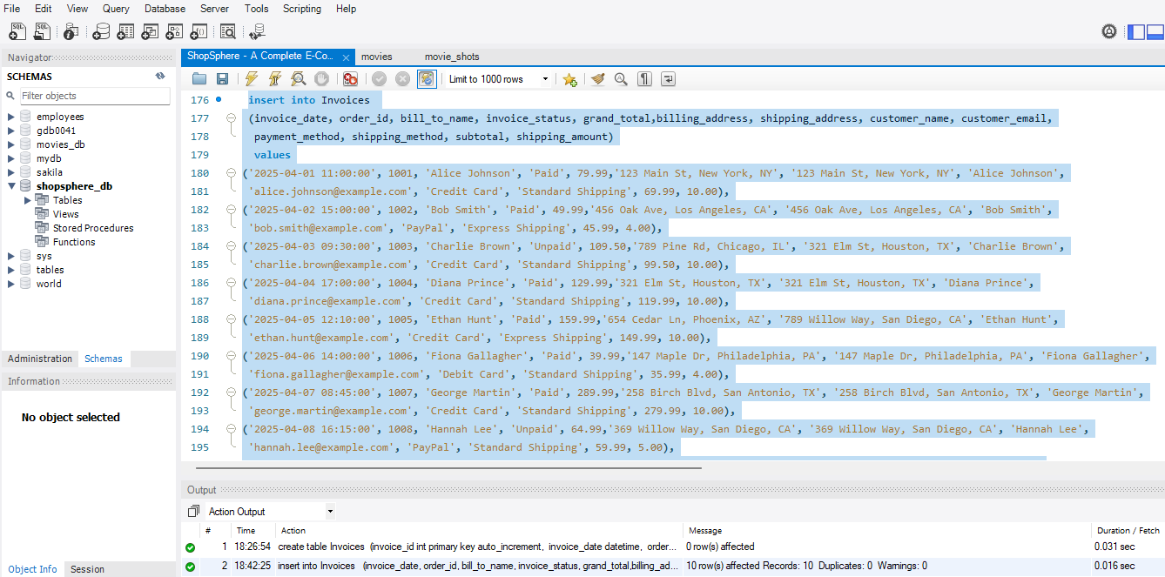
Inserted values on the Invoices table
- Inserted ten values in the Invoices table

Slide 33
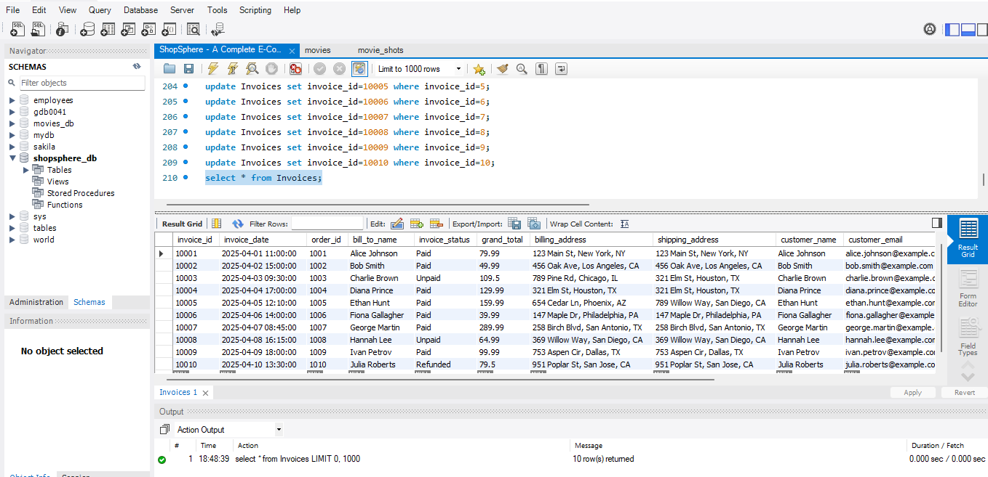
View all values in the Invoices table
To view all the values in the Invoices table, executed the query as
select * from Invoices;

Slide 34
Creating Table - 6: Shipments
To create the Shipments table under the database, execute the query as
create table Shipments
(shipment_id int primary key,
ship_date datetime not null,
order_id int not null,
order_date datetime not null,
ship_to_name varchar(30) not null,
total_quantity int check (total_quantity>=0),
order_status varchar(30) check (order_status) in ('Pending', 'Shipped', 'Completed', 'Cancelled')),
customer_name varchar(30),
customer_email varchar(30),
billing_address text,
shipping_address text,
payment_method varchar(30),
shipping_method varchar(30) check(shipping_method in('Standard Shipping','Express Shipping')),
foreign key (order_id) references SalesOrder (order_id));

Slide 35
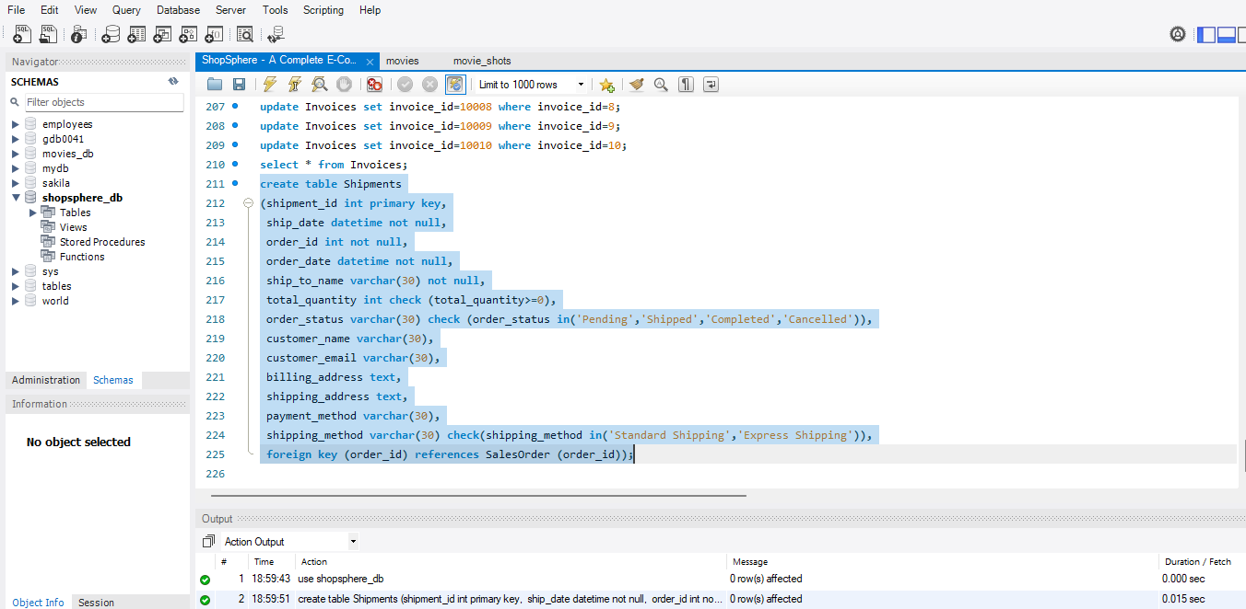
Created Shipments Table
- Created the table by using the primary key, foreign key, not null, in, check constraint with different data types
- Columns include the shipment id, ship date, order id, order date, ship to name, total quantity, order status, customer name, customer email, billing address, shipping address, payment method, shipping method.
- Here, the shipment id is used as the primary key, because shipment id should not be null values and also the foreign key is used for the order id column which is referenced with the Sales Order table.
- Also, here used the check constraint whether the values for the columns order status and shipping method are given in the query to execute.

Slide 36
Inserting Values on Table 6: Shipments
To insert ten values on the Shipments table, executed the query as
insert into Shipments
(shipment_id, ship_date, order_id, order_date, ship_to_name, total_quantity, order_status, customer_name, customer_email, billing_address, shipping_address, payment_method, shipping_method)
values
(100001,'2025-04-02 09:00:00', 1001, '2025-04-01 10:15:00', 'Alice Johnson', 3, 'Completed', 'Alice Johnson', 'alice.johnson@example.com', '123 Main St, New York, NY', '123 Main St, New York, NY','Credit Card', 'Standard Shipping'),
(100002, '2025-04-03 12:30:00', 1002, '2025-04-02 14:30:00', 'Bob Smith', 2, 'Shipped','Bob Smith', 'bob.smith@example.com', '456 Oak Ave, Los Angeles, CA', '456 Oak Ave, Los Angeles, CA', 'PayPal', 'Express Shipping'),
(100003, '2025-04-04 11:00:00', 1003, '2025-04-03 09:00:00', 'Lucy Van Pelt', 5, 'Pending', 'Charlie Brown', 'charlie.brown@example.com', '789 Pine Rd, Chicago, IL', '321 Elm St, Houston, TX', 'Credit Card', 'Standard Shipping'),
(100004, '2025-04-05 14:00:00', 1004, '2025-04-04 16:20:00', 'Diana Prince', 4, 'Completed', 'Diana Prince', 'diana.prince@example.com', '321 Elm St, Houston, TX', '321 Elm St, Houston, TX', 'Credit Card', 'Standard Shipping'),
(100005, '2025-04-06 15:30:00', 1005, '2025-04-05 11:45:00', 'Benji Dunn', 6, 'Shipped','Ethan Hunt', 'ethan.hunt@example.com', '654 Cedar Ln, Phoenix, AZ', '789 Willow Way, San Diego, CA','Credit Card', 'Express Shipping'),
(100006, '2025-04-07 10:00:00', 1006, '2025-04-06 13:10:00', 'Fiona Gallagher', 1, 'Completed', 'Fiona Gallagher', 'fiona.gallagher@example.com','147 Maple Dr, Philadelphia, PA', '147 Maple Dr, Philadelphia, PA','Debit Card', 'Standard Shipping'),
(100007, '2025-04-08 08:45:00', 1007, '2025-04-07 08:00:00', 'George Martin', 7, 'Completed', 'George Martin', 'george.martin@example.com', '258 Birch Blvd, San Antonio, TX', '258 Birch Blvd, San Antonio, TX', 'Credit Card', 'Standard Shipping'),
(100008, '2025-04-09 16:30:00', 1008, '2025-04-08 15:45:00', 'Hannah Lee', 2, 'Pending', 'Hannah Lee', 'hannah.lee@example.com', '369 Willow Way, San Diego, CA', '369 Willow Way, San Diego, CA','PayPal', 'Standard Shipping'),
(100009,'2025-04-10 13:20:00', 1009, '2025-04-09 17:25:00', 'Ivan Petrov', 3, 'Completed', 'Ivan Petrov', 'ivan.petrov@example.com', '753 Aspen Cir, Dallas, TX', '753 Aspen Cir, Dallas, TX','Credit Card', 'Express Shipping'),
(100010, '2025-04-11 11:10:00', 1010, '2025-04-10 12:50:00', 'Julia Roberts', 2, 'Cancelled', 'Julia Roberts', 'julia.roberts@example.com', '951 Poplar St, San Jose, CA', '951 Poplar St, San Jose, CA','Credit Card', 'Standard Shipping');

Slide 37
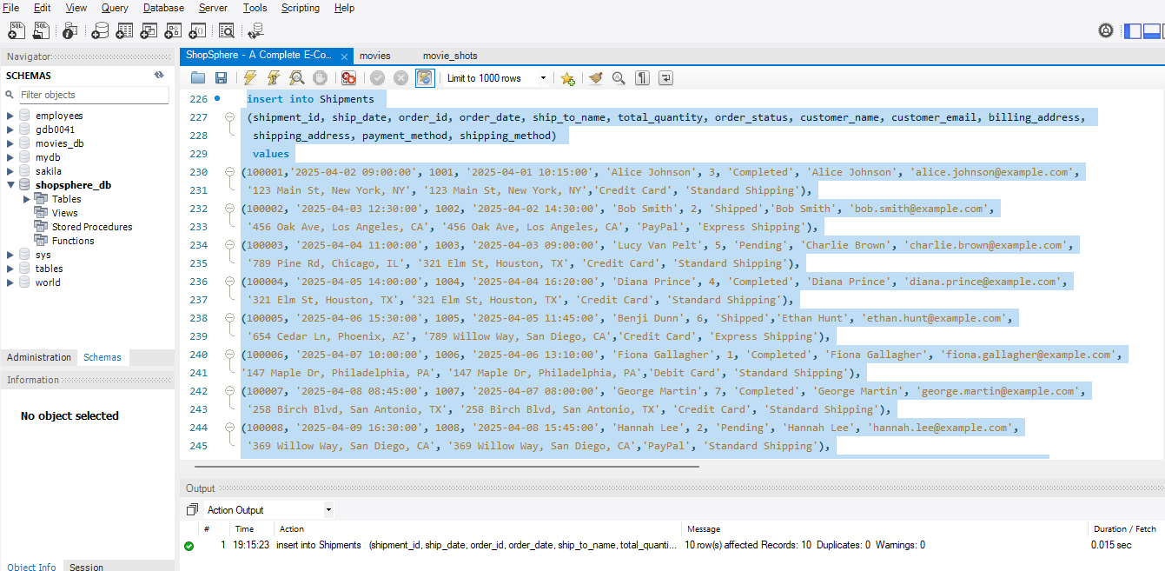
Inserted values on the Shipments table
- Inserted ten values in the Shipments table

Slide 38
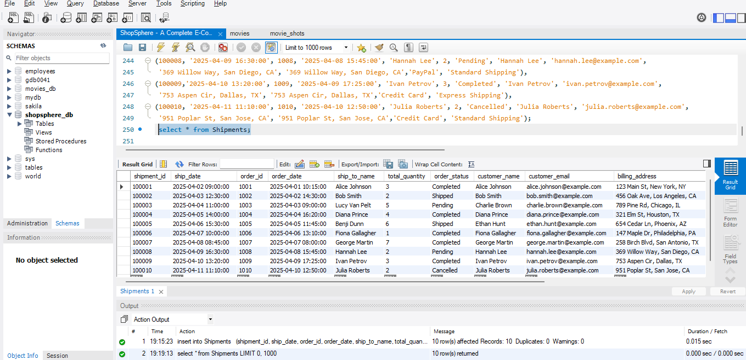
View all values in the Shipments table
To view all the values in the Shipments table, executed the query as
select * from Shipments;

Slide 39
Creating Table - 7: Credit Memos
To create the Credit Memos table under the database, execute the query as
create table CreditMemos
(credit_memo_id int primary key,
created_date datetime,
order_id int,
order_date datetime,
bill_to_name varchar(30),
ship_to_name VARCHAR(30),
status varchar(30) check (status in ('Open', 'Closed', 'Canceled')),
refunded float check (refunded >= 0),
order_status varchar(30) check (order_status in ('Pending', 'Shipped', 'Completed', 'Cancelled')),
billing_address text,
shipping_address text,
customer_name varchar(30),
customer_email varchar(30),
payment_method varchar(30),
shipping_method varchar(30) check (shipping_method in ('Standard Shipping', 'Express Shipping')),
subtotal float,
shipping_amount float,
grand_total float check (grand_total >= 0),
foreign key (order_id) references SalesOrder(order_id));

Slide 40
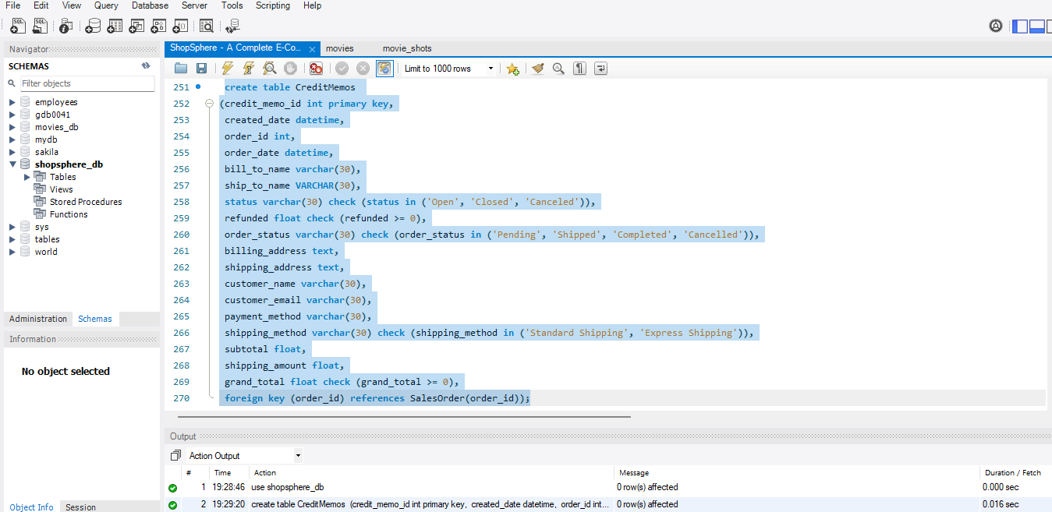
Created Credit Memos Table
- Created the table by using the primary key, foreign key, in, check constraint with different data types
- Columns include the credit memo id, created date, order id, order date, bill to name, ship to name, status, refunded, order status, billing address, shipping address, customer name, customer email, payment method, shipping method, subtotal, shipping amount, grand total.
- Here, the credit memo id is used as the primary key, because credit memo id should not be null values and also the foreign key is used for the order id column which is referenced with the Sales Order table.
- Also, here used the check constraint whether the values for the columns status , order status and shipping method are given in the query to execute.

Slide 41
Inserting Values on Table 7: Credit Memos
To insert ten values on the Credit Memos table, executed the query as
insert into CreditMemos
(credit_memo_id, created_date, order_id, order_date, bill_to_name, ship_to_name, status, refunded, order_status, billing_address, shipping_address, customer_name, customer_email, payment_method, shipping_method, subtotal, shipping_amount, grand_total)
values
(1000001,'2025-04-12 09:00:00', 1001, '2025-04-01 10:15:00', 'Alice Johnson', 'Alice Johnson', 'Closed', 79.99, 'Cancelled', '123 Main St, New York, NY', '123 Main St, New York, NY','Alice Johnson', 'alice.johnson@example.com', 'Credit Card', 'Standard Shipping', 69.99, 10.00, 79.99),
(1000002, '2025-04-13 14:30:00', 1002, '2025-04-02 14:30:00', 'Bob Smith', 'Bob Smith', 'Open', 49.99, 'Cancelled', '456 Oak Ave, Los Angeles, CA', '456 Oak Ave, Los Angeles, CA','Bob Smith', 'bob.smith@example.com', 'PayPal', 'Express Shipping', 45.99, 4.00, 49.99),
(1000003, '2025-04-14 11:15:00', 1003, '2025-04-03 09:00:00', 'Charlie Brown', 'Lucy Van Pelt', 'Closed', 109.50,'Cancelled', '789 Pine Rd, Chicago, IL', '321 Elm St, Houston, TX','Charlie Brown', 'charlie.brown@example.com', 'Credit Card', 'Standard Shipping', 99.50, 10.00, 109.50),
(1000004,'2025-04-15 13:20:00', 1004, '2025-04-04 16:20:00', 'Diana Prince', 'Diana Prince', 'Closed', 129.99,'Cancelled', '321 Elm St, Houston, TX', '321 Elm St, Houston, TX','Diana Prince', 'diana.prince@example.com', 'Credit Card', 'Standard Shipping', 119.99, 10.00, 129.99),
(1000005,'2025-04-16 16:00:00', 1005, '2025-04-05 11:45:00', 'Ethan Hunt', 'Benji Dunn', 'Open', 159.99, 'Cancelled', '654 Cedar Ln, Phoenix, AZ', '789 Willow Way, San Diego, CA','Ethan Hunt', 'ethan.hunt@example.com', 'Credit Card', 'Express Shipping', 149.99, 10.00, 159.99),
(1000006,'2025-04-17 10:00:00', 1006, '2025-04-06 13:10:00', 'Fiona Gallagher', 'Fiona Gallagher', 'Closed', 39.99, 'Cancelled','147 Maple Dr, Philadelphia, PA', '147 Maple Dr, Philadelphia, PA', 'Fiona Gallagher', 'fiona.gallagher@example.com', 'Debit Card', 'Standard Shipping', 35.99, 4.00, 39.99),
(1000007, '2025-04-18 12:00:00', 1007, '2025-04-07 08:00:00', 'George Martin', 'George Martin', 'Closed', 289.99, 'Cancelled', '258 Birch Blvd, San Antonio, TX', '258 Birch Blvd, San Antonio, TX','George Martin', 'george.martin@example.com', 'Credit Card', 'Standard Shipping', 279.99, 10.00, 289.99),
(1000008,'2025-04-19 11:45:00', 1008, '2025-04-08 15:45:00', 'Hannah Lee', 'Hannah Lee', 'Open', 64.99,'Cancelled', '369 Willow Way, San Diego, CA', '369 Willow Way, San Diego, CA','Hannah Lee', 'hannah.lee@example.com', 'PayPal', 'Standard Shipping', 59.99, 5.00, 64.99),
(1000009,'2025-04-20 15:30:00', 1009, '2025-04-09 17:25:00', 'Ivan Petrov', 'Ivan Petrov', 'Closed', 99.99,'Cancelled', '753 Aspen Cir, Dallas, TX', '753 Aspen Cir, Dallas, TX', 'Ivan Petrov', 'ivan.petrov@example.com', 'Credit Card', 'Express Shipping', 89.99, 10.00, 99.99),
(1000010,'2025-04-21 09:30:00', 1010, '2025-04-10 12:50:00', 'Julia Roberts', 'Julia Roberts', 'Closed', 79.50, 'Cancelled', '951 Poplar St, San Jose, CA', '951 Poplar St, San Jose, CA','Julia Roberts', 'julia.roberts@example.com', 'Credit Card', 'Standard Shipping', 69.50, 10.00, 79.50);

Slide 42
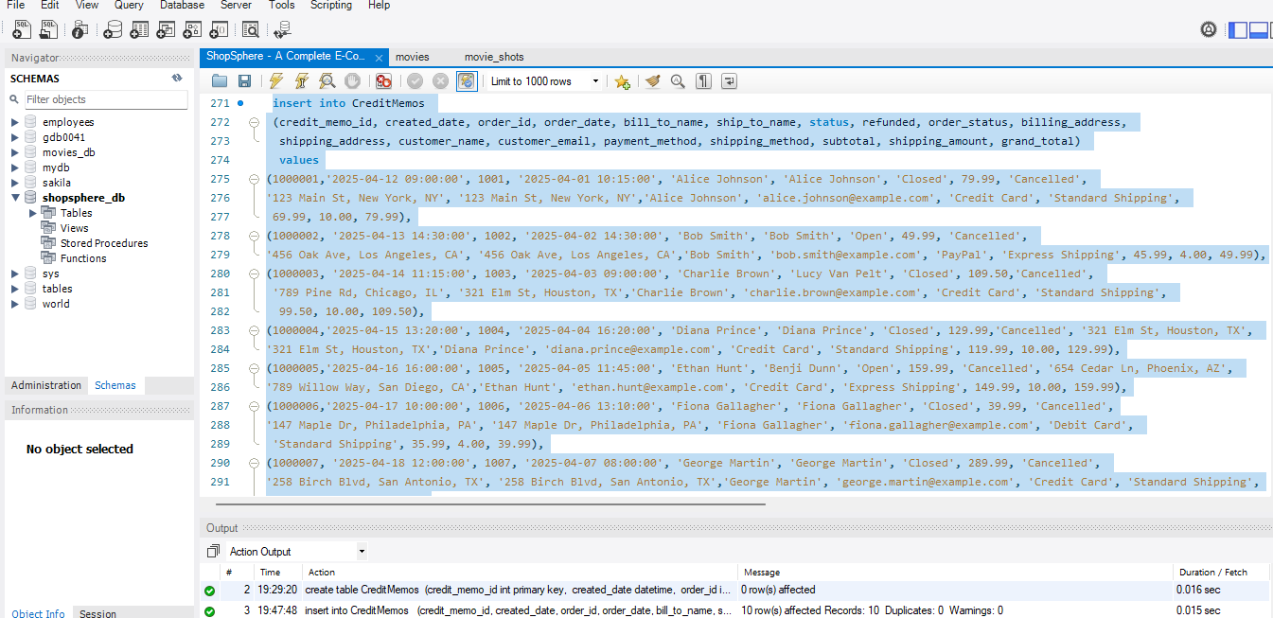
Inserted values on the Credit Memos table
- Inserted ten values in the Credit Memos table

Slide 43
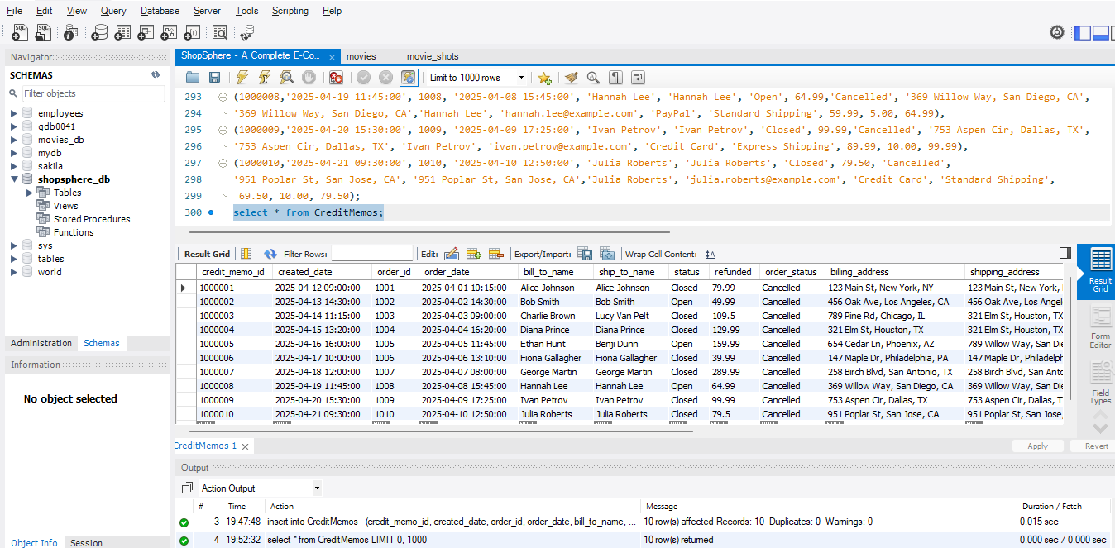
View all values in the Credit Memos table
To view all the values in the Credit Memos table, executed the query as
select * from CreditMemos;

Slide 44
Creating Table - 8: Reviews
To create the Reviews table under the database, execute the query as
create table Reviews
(review_id int primary key,
created_at datetime,
status varchar(30) check (status in ('Pending', 'Approved', 'Rejected')),
title varchar(100),
reviewer_name varchar(30),
review text,
type varchar(30) check (type in('Product','Service')),
prod_id int,
product_name varchar(30),
sku varchar(30),
foreign key (prod_id) references Products(prod_id));

Slide 45
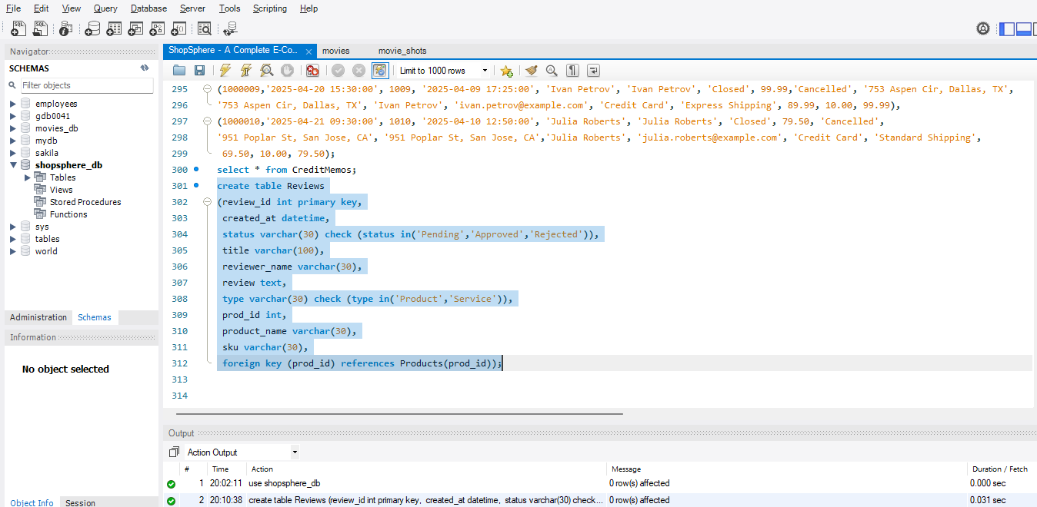
Created Reviews Table
- Created the table by using the primary key, foreign key, in, check constraint with different data types
- Columns include the review id, created at, status, title, reviewer name, review, type, product id, product name, sku.
- Here, the review id is used as the primary key, because review id should not be null values and also the foreign key is used for the product id column which is referenced with the Products table.
- Also, here used the check constraint whether the values for the columns status and type are given in the query to execute.

Slide 46
Inserting Values on Table 8: Reviews
To insert ten values on the Reviews table, executed the query as
insert into Reviews
(review_id, created_at, status, title, reviewer_name, review, type, prod_id, product_name, sku)
values
(2001,'2025-04-01 09:30:00', 'Approved', 'Smooth and reliable', 'Alice Johnson', 'Wireless Mouse works flawlessly and battery lasts long.', 'Product', 101, 'Wireless Mouse', 'SKU001'),
(2002,'2025-04-02 11:10:00', 'Approved', 'Impressive Sound', 'Bob Smith', 'The Bluetooth Speaker has great bass and clarity.', 'Product', 102, 'Bluetooth Speaker', 'SKU002'),
(2003,'2025-04-03 14:00:00', 'Approved', 'Comfortable and durable', 'Clara Lee', 'Running Shoes fit well and are great for jogging.', 'Product', 103, 'Running Shoes', 'SKU003'),
(2004, '2025-04-04 10:20:00', 'Pending', 'Basic quality', 'David Kim', 'Notebook pages are thinner than expected.', 'Product', 104, 'Notebook', 'SKU004'),
(2005, '2025-04-05 16:45:00', 'Approved', 'Perfect for gamers', 'Ethan Hunt', 'Gaming Keyboard is tactile and lights up beautifully.', 'Product', 105, 'Gaming Keyboard', 'SKU005'),
(2006, '2025-04-06 12:10:00', 'Approved', 'Great for daily use', 'Fatima Noor', 'Backpack is spacious, sturdy, and stylish.', 'Product', 106, 'Backpack', 'SKU006'),
(2007, '2025-04-07 08:55:00', 'Approved', 'Keeps drinks cold', 'George Martin', 'Water Bottle kept my drink cold for 10+ hours.', 'Product', 107, 'Water Bottle', 'SKU007'),
(2008,'2025-04-08 17:30:00', 'Pending', 'Good but pricey', 'Hannah Lee', 'LED Monitor looks great but is a bit expensive.', 'Product', 108, 'LED Monitor', 'SKU008'),
(2009, '2025-04-09 13:05:00', 'Rejected', 'Disappointed', 'Ian Wright', 'Office Chair is not very comfortable.', 'Product', 109, 'Office Chair', 'SKU009'),
(2010, '2025-04-10 09:15:00', 'Approved', 'Stylish shades', 'Julia Roberts', 'Sunglasses look great and fit well.', 'Product', 110, 'Sunglasses', 'SKU010');

Slide 47
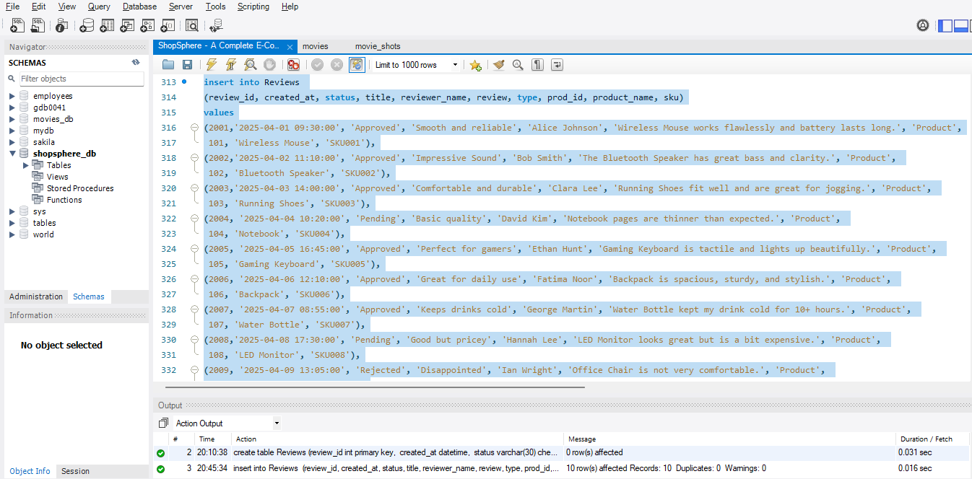
Inserted values on the Reviews table
- Inserted ten values in the Reviews table

Slide 48
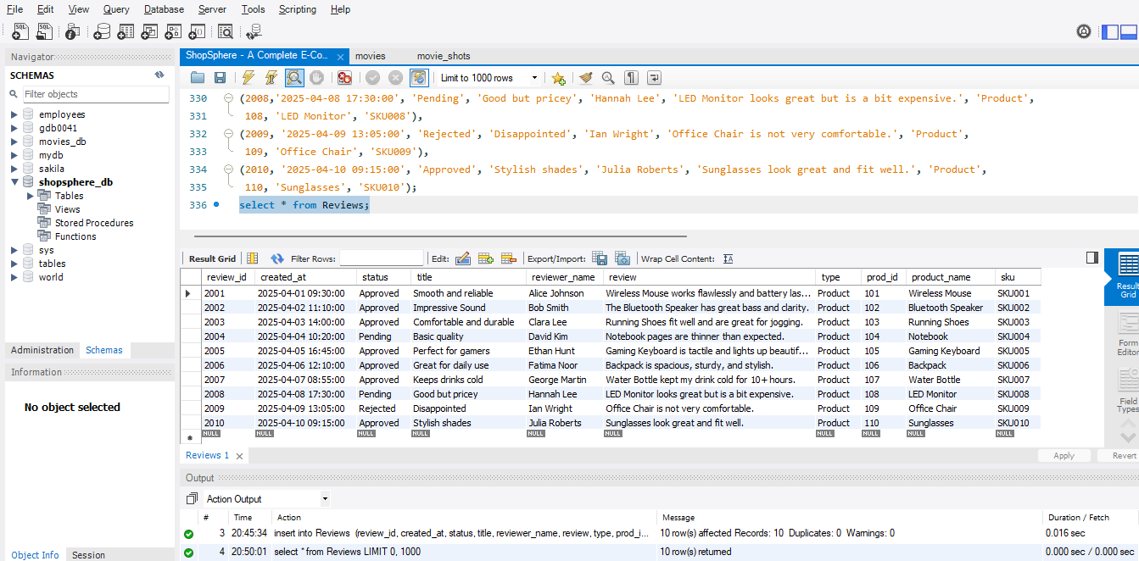
View all values in the Reviews table
To view all the values in the Reviews table, executed the query as
select * from Reviews;

Slide 49
Creating Table - 9: Newsletter Subscribers
To create the Newsletter Subscribers table under the database, execute the query as
create table NewsletterSubscribers
(id int primary key,
email varchar(30) unique key,
customer_first_name varchar(30),
customer_last_name varchar(30),
status varchar(30));

Slide 50
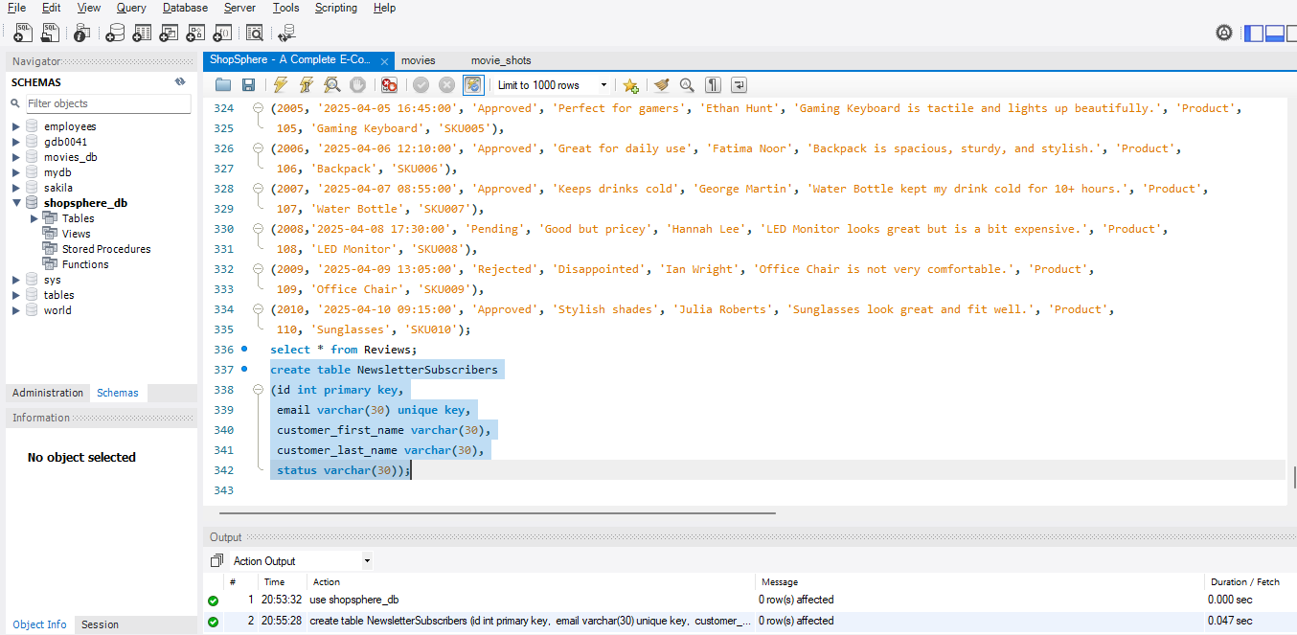
Created Newsletter Subscribers Table
- Created the table by using the primary key and unique key with different data types
- Columns include the id, email, customer first name, customer last name, status.
- Here, the id is used as the primary key, because id should not be null values and also the unique key is used for the email column.

Slide 51
Inserting Values on Table 9: Newsletter Subscribers
To insert ten values on the Newsletter Subscribers table, executed the query as
insert into NewsletterSubscribers
(id, email, customer_first_name, customer_last_name, status)
values
(20001, 'alice.johnson@example.com', 'Alice', 'Johnson', 'Subscribed'),
(20002, 'bob.smith@example.com', 'Bob', 'Smith', 'Subscribed'),
(20003, 'clara.lee@example.com', 'Clara', 'Lee', 'Pending'),
(20004, 'david.kim@example.com', 'David', 'Kim', 'Unsubscribed'),
(20005, 'ethan.hunt@example.com', 'Ethan', 'Hunt', 'Subscribed'),
(20006, 'fatima.noor@example.com', 'Fatima', 'Noor', 'Pending'),
(20007, 'george.martin@example.com', 'George', 'Martin', 'Subscribed'),
(20008, 'hannah.lee@example.com', 'Hannah', 'Lee', 'Unsubscribed'),
(20009, 'ian.wright@example.com', 'Ian', 'Wright', 'Subscribed'),
(20010, 'julia.roberts@example.com', 'Julia', 'Roberts', 'Subscribed');

Slide 52
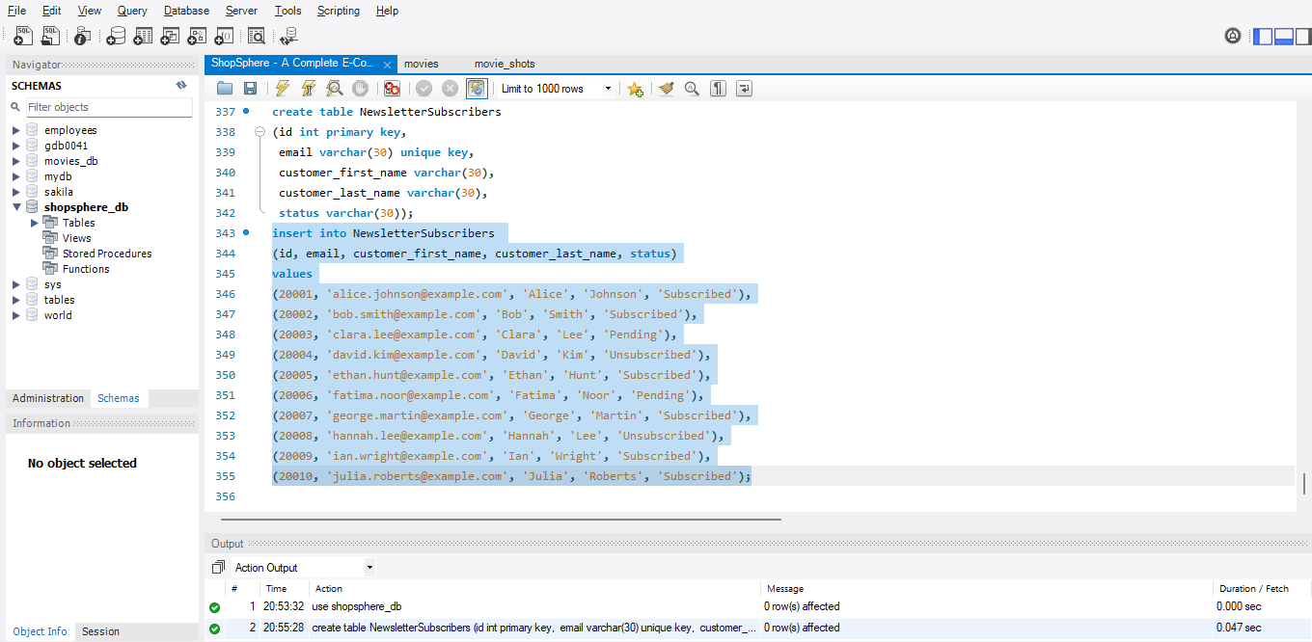
Inserted values on the Newsletter Subscribers table
- Inserted ten values in the Newsletter Subscribers table

Slide 53
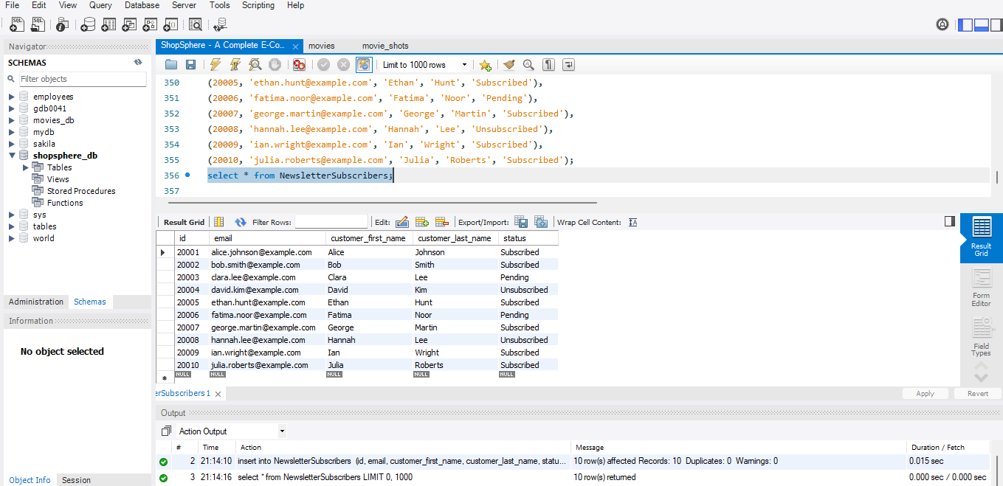
View all values in the Newsletter Subscribers table
To view all the values in the Newsletter Subscribers table, executed the query as
select * from NewsletterSubscribers;

Slide 54
Creating Table - 10: Wishlist
To create the Wishlist table under the database, execute the query as
create table Wishlist
(wishlist_id int primary key,
added_date datetime,
customer_name varchar(30),
prod_id int,
prod_name varchar(30),
sku varchar(30) unique key,
comments text,
foreign key (prod_id) references Products(prod_id));

Slide 55
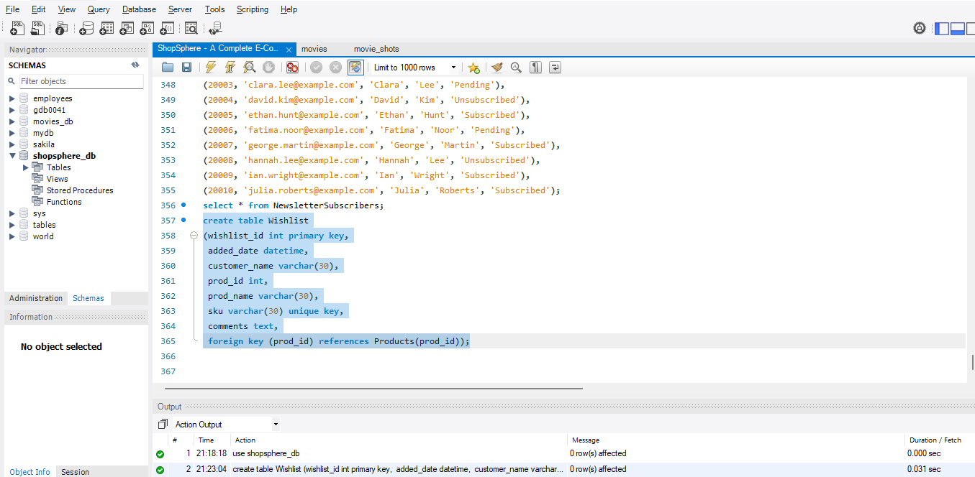
Created Wishlist Table
- Created the table by using the primary key and unique key with different data types
- Columns include the wishlist id, added date, customer name, product id, product name, sku, comments.
- Here, the wishlist id is used as the primary key, because wishlist id should not be null values and also the unique key is used for the sku column.

Slide 56
Inserting Values on Table 10: Wishlist
To insert ten values on the Wishlist table, executed the query as
insert into Wishlist
(wishlist_id, added_date, customer_name, prod_id, prod_name, sku, comments)
values
(200001, '2025-05-01 09:30:00', 'Alice Johnson', 101, 'Wireless Mouse', 'SKU001', 'Looking for a budget-friendly mouse.'),
(200002, '2025-05-01 10:45:00', 'Bob Smith', 102, 'Bluetooth Speaker', 'SKU002', 'Might buy if the price drops.'),
(200003, '2025-05-02 14:15:00', 'Clara Lee', 103, 'Running Shoes', 'SKU003', 'Perfect for morning runs.'),
(200004, '2025-05-03 11:20:00', 'David Kim', 104, 'Notebook', 'SKU004', 'Need more for school notes.'),
(200005, '2025-05-04 08:10:00', 'Ethan Hunt', 105, 'Gaming Keyboard', 'SKU005', 'Want RGB backlit version.'),
(200006, '2025-05-05 15:35:00', 'Fatima Noor', 106, 'Backpack', 'SKU006', 'Looks durable for travel.'),
(200007, '2025-05-06 13:00:00', 'George Martin', 107, 'Water Bottle', 'SKU007', 'Useful for gym sessions.'),
(200008, '2025-05-07 16:25:00', 'Hannah Lee', 108, 'LED Monitor', 'SKU008', 'Waiting for discount.'),
(200009, '2025-05-08 12:50:00', 'Ian Wright', 109, 'Office Chair', 'SKU009', 'Considering for home office.'),
(200010, '2025-05-08 17:10:00', 'Julia Roberts', 110, 'Sunglasses', 'SKU010', 'Nice style, will buy for summer.');

Slide 57
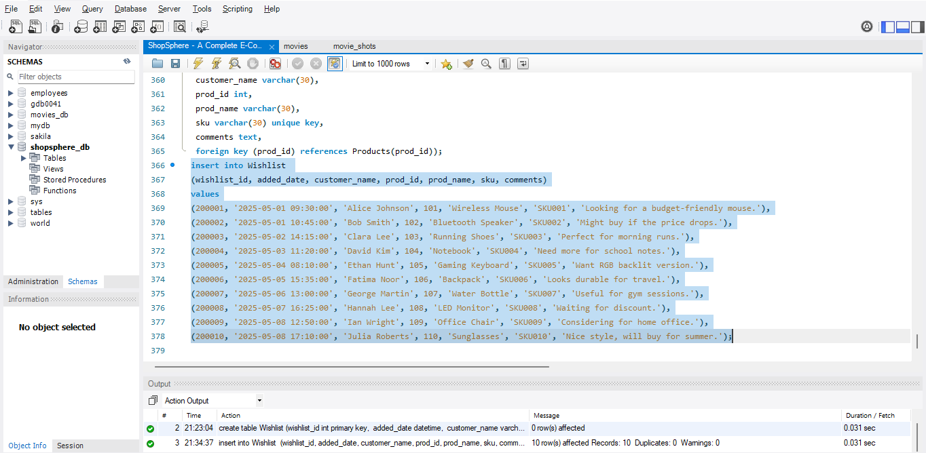
Inserted values on the Wishlist table
- Inserted ten values in the Wishlist table

Slide 58
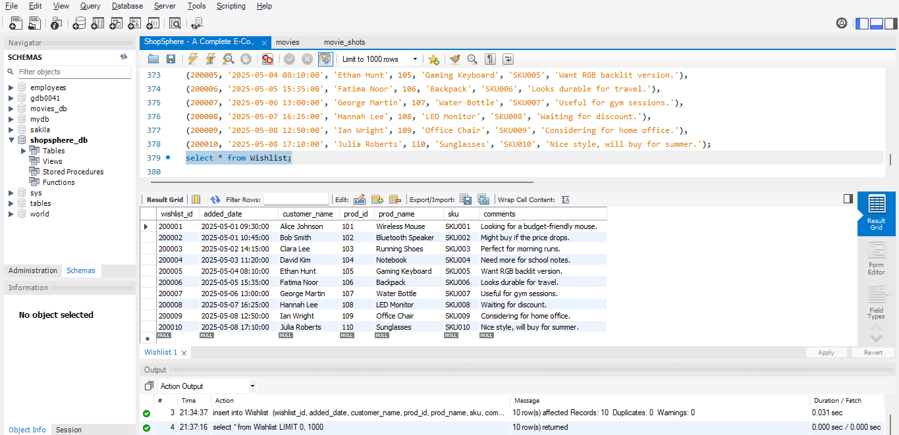
View all values in the Wishlist table
To view all the values in the Wishlist table, executed the query as
select * from Wishlist;

Slide 59
JOINS

Slide 60
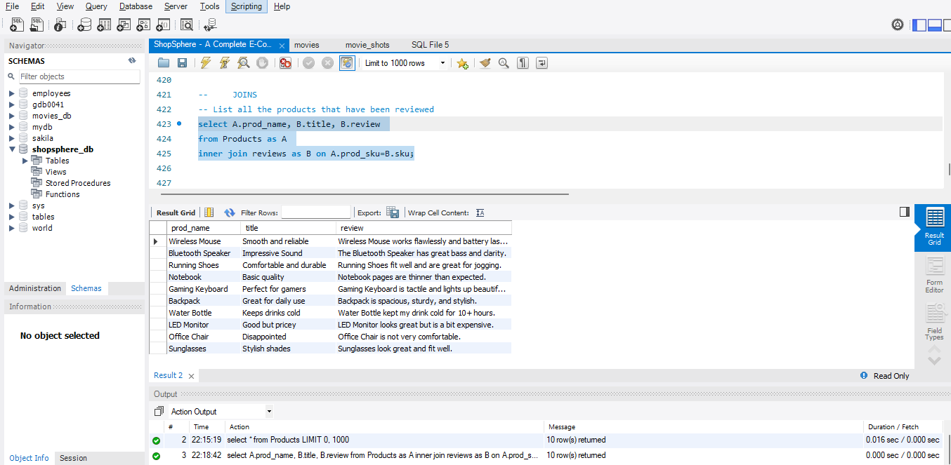
1. List all products that have been reviewed
select A.prod_name, B.title, B.review
from Products as A
inner join reviews as B on A.prod_sku=B.sku;

Slide 61
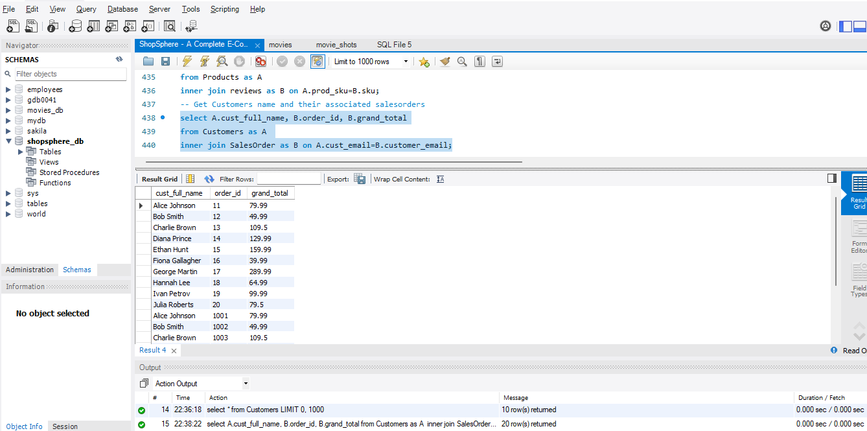
2. Get Customer Name and associated Sales order
select A.cust_full_name, B.order_id, B.grand_total
from Customers as A
inner join SalesOrder as B on A.cust_email=B.customer_email;

Slide 62
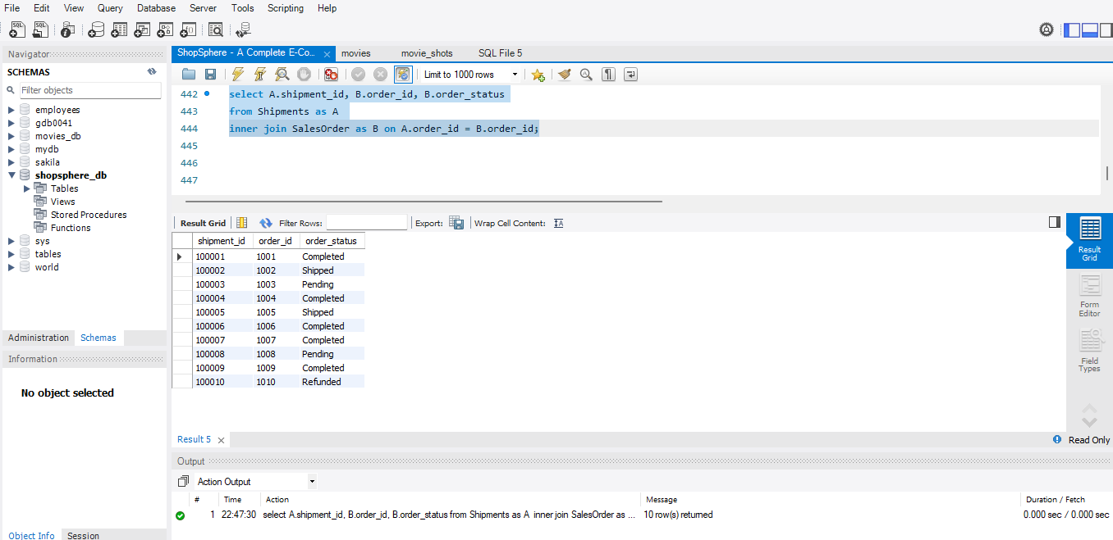
3. Find Shipments with their corresponding sales order status
select A.shipment_id, B-order_id, B.order_status
from Shipments as A
inner join SalesOrder as B on A.order_id = B.order_id;

Slide 63
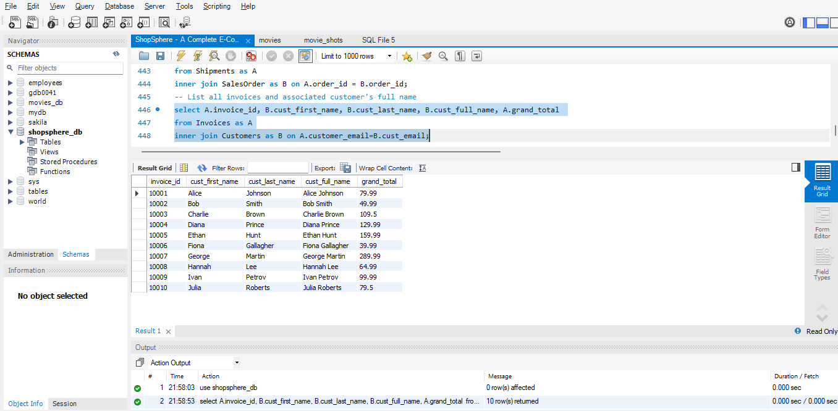
4. List all Invoices and associated Customer’s full name
select A.invoice_id, B.cust_first_name, B.cust_last_name, B.cust_full_name, A.grand_total
from Invoices as A
inner join Customers as B on A.customer_email=B.cust_email;

Slide 64
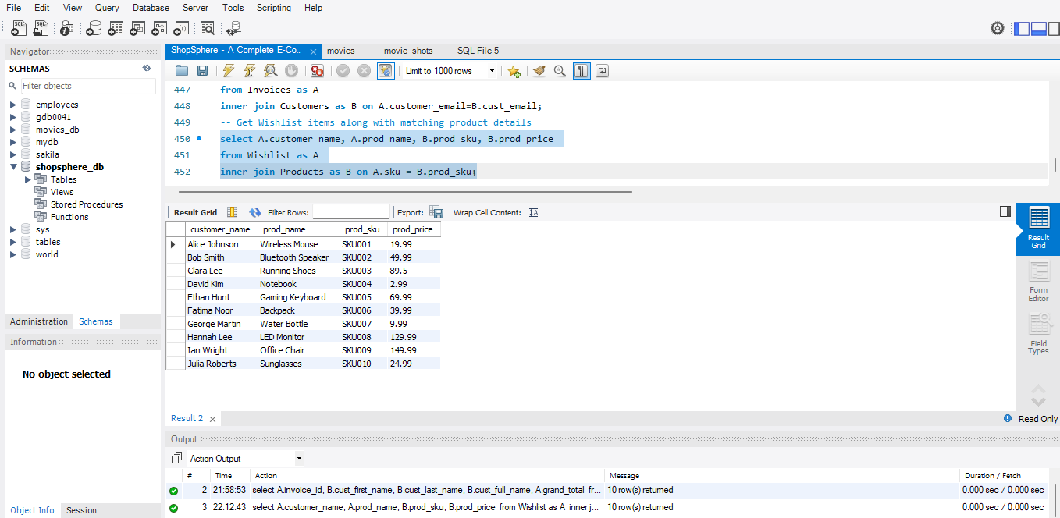
5. Get Wishlist items along with matching product details
select A.customer_name, A.prod_name, B.prod_sku, B.prod_price
from Wishlist as A
inner join Products as B on A.sku = B.prod_sku;

Slide 65
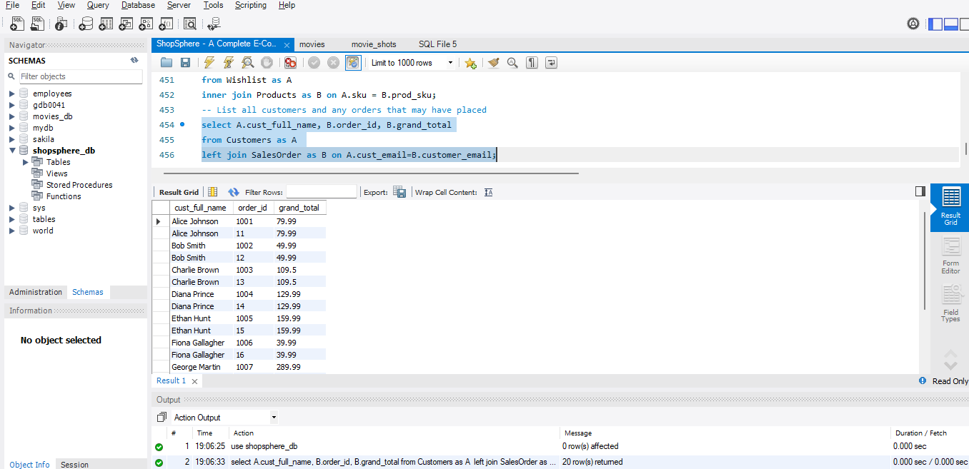
6. List all Customers and any orders they may have placed
select A.cust_full_name, B.order_id, B.grand_total
from Customers as A
left join SalesOrder as B on A.cust_email=B.customer_email;

Slide 66
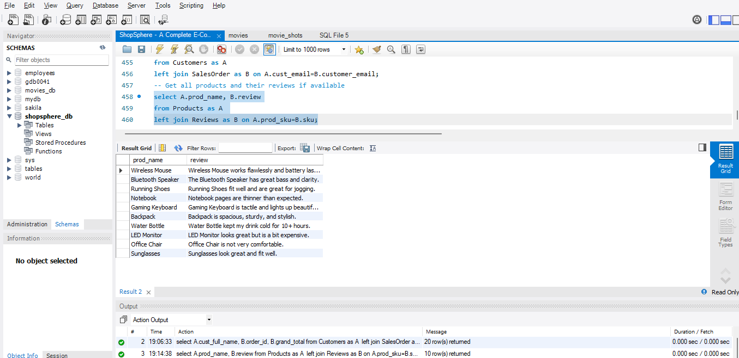
7. Get all products and their reviews if available
select A.prod_name, B.review
from Products as A
left join Reviews as B on A.prod_sku=B.sku;

Slide 67
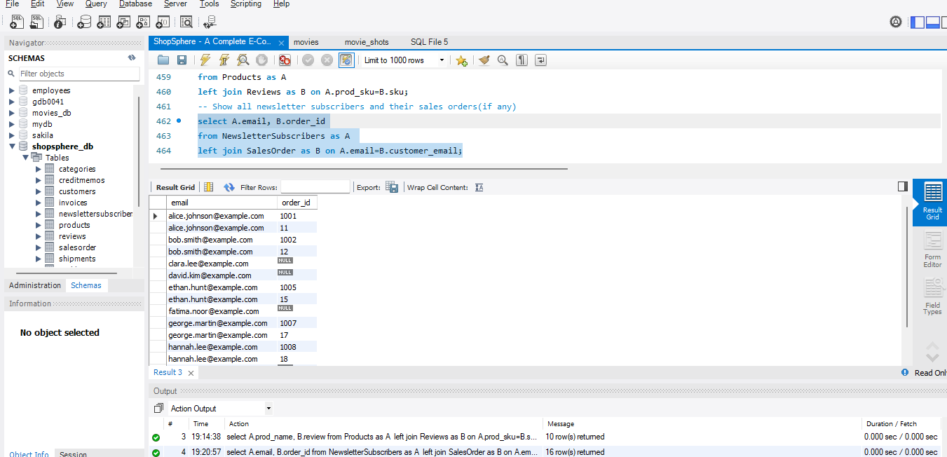
8. Show all newsletter subscribers and their sales orders(if any)
select A.email, B.order_id
from NewsletterSubscribers as A
left join SalesOrder as B on A.email=B.customer_email;

Slide 68
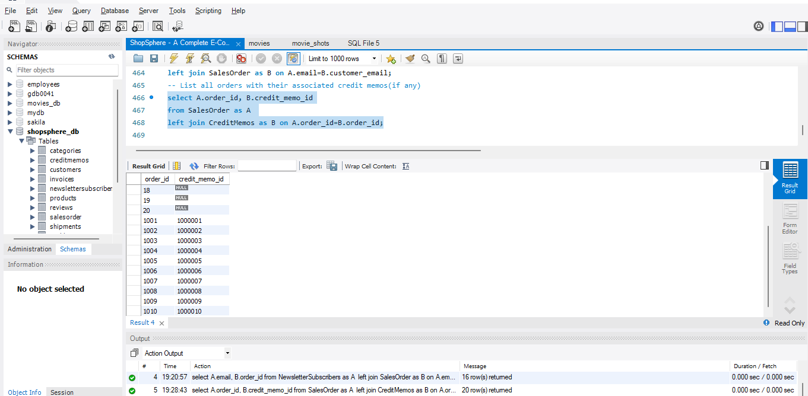
9. List all orders with their associated credit memos(if any)
select A.order_id, B.credit_memo_id
from SalesOrder as A
left join CreditMemos as B on A.order_id=B.order_id;

Slide 69
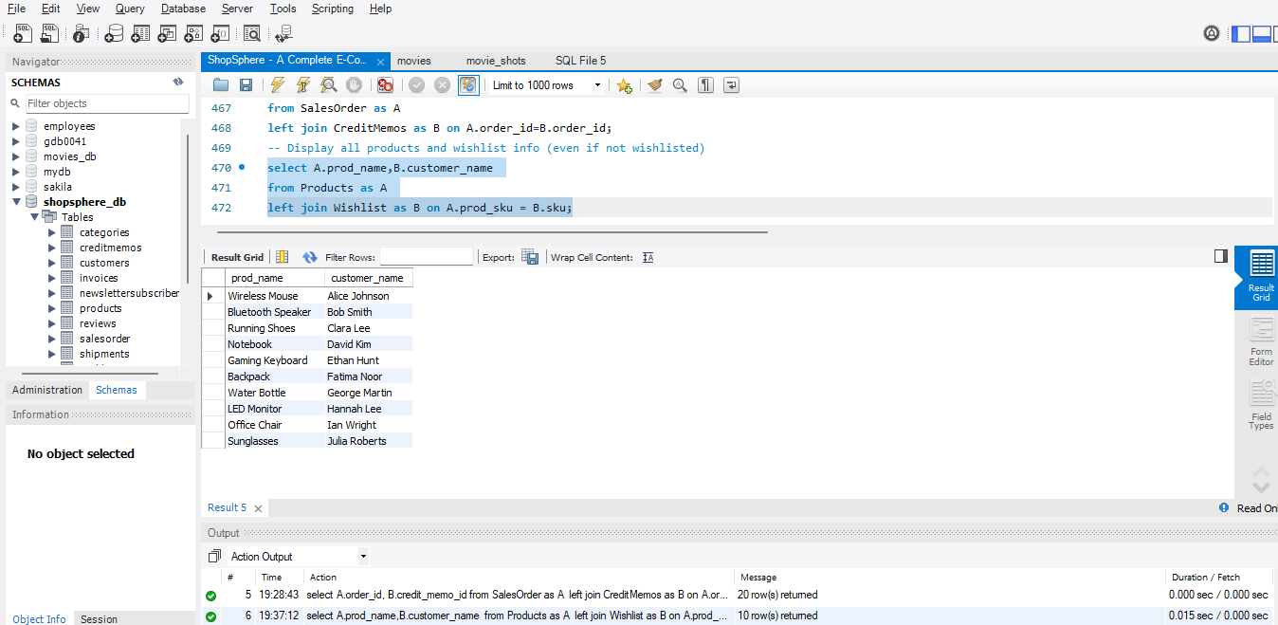
10. Display all products and wishlist info (even if not wishlisted)
select A.prod_name,B.customer_name
from Products as A
left join Wishlist as B on A.prod_sku = B.sku;

Slide 70
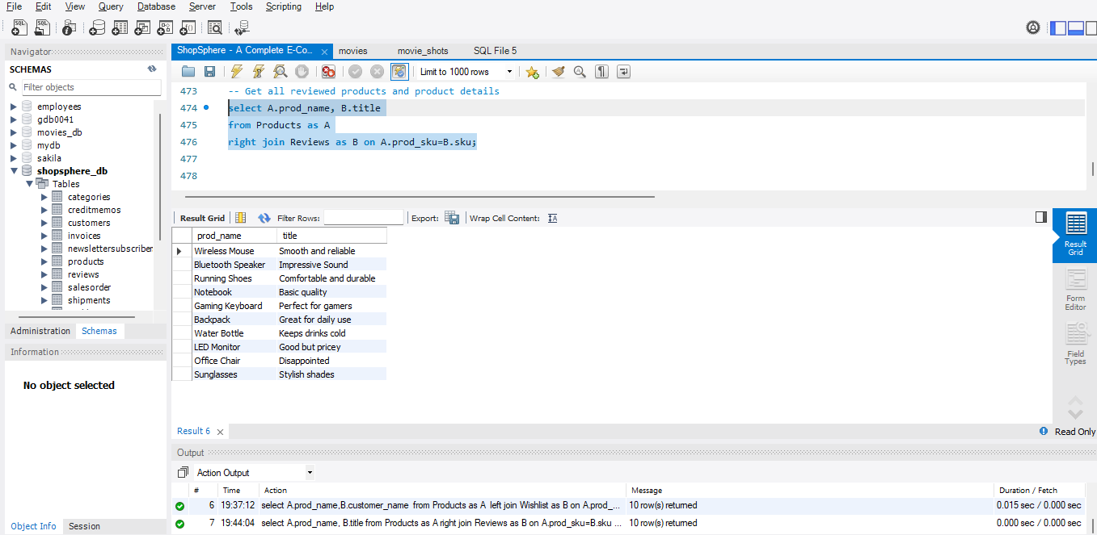
11. Get all reviewed products and product details
select A.prod_name, B.title
from Products as A
right join Reviews as B on A.prod_sku=B.sku;

Slide 71
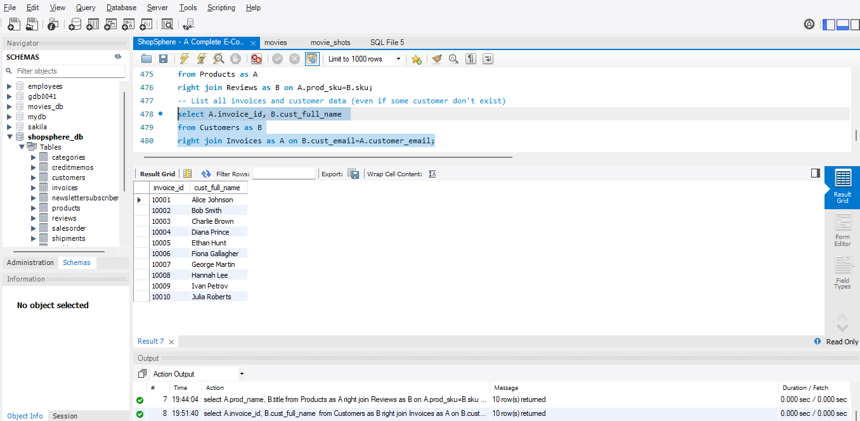
12. List all invoices and customer data (even if some customer don't exist)
select A.invoice_id, B.cust_full_name
from Customers as B
right join Invoices as A on B.cust_email=A.customer_email;

Slide 72
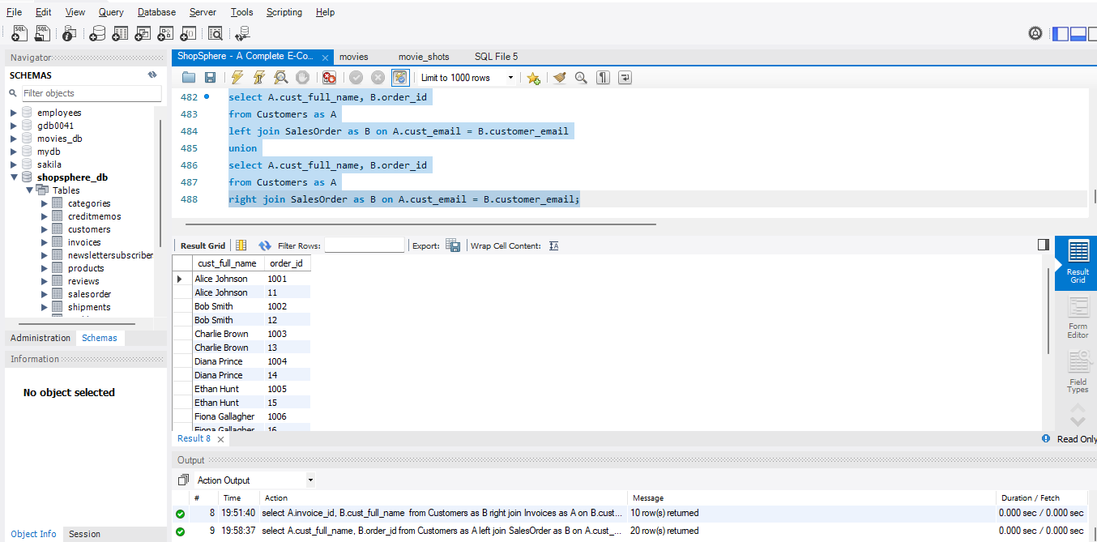
13. List all customers and orders(including unmatched in both tables)
select A.cust_full_name, B.order_id
from Customers as A
left join SalesOrder as B on A.cust_email = B.customer_email
union
select A.cust_full_name, B.order_id
from Customers as A
right join SalesOrder as B on A.cust_email = B.customer_email;

Slide 73
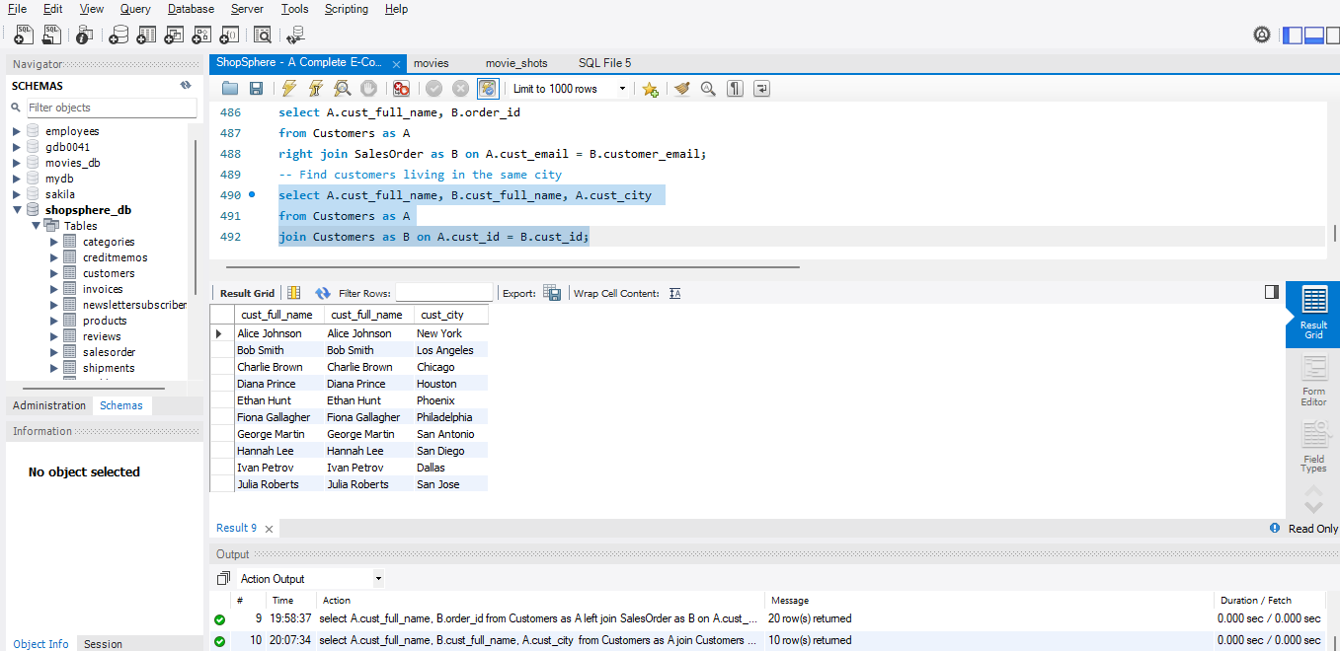
14. List all customers and orders(including unmatched in both tables)
select A.cust_full_name, B.cust_full_name, A.cust_city
from Customers as A
join Customers as B on A.cust_id = B.cust_id;

Slide 74

15. List order details along with invoices and shipment info
select A.order_id, B.invoice_id, C.shipment_id
from SalesOrder as A
join Invoices as B on A.order_id=B.order_id
join Shipments as C on A.order_id=C.order_id;

Slide 75

16. Find product reviews with customer emails who added them to wishlist
select A.product_name, B.customer_name, A.review
from Reviews as A
join Wishlist as B on A.sku=B.sku;

Slide 76

17. List customer orders and associated credit memos
select A.cust_full_name, B.order_id, C.credit_memo_id
from Customers as A
join SalesOrder as B on A.cust_email=B.customer_email
join CreditMemos as C on B.order_id=C.order_id;

Slide 77

18. Find products and their categories
select A.prod_name, B.category_name
from Products as A
join Categories as B on A.prod_id=B.category_id;

Slide 78

19. Match Newsletter Subscribers with actual customers
select A.email, B.cust_full_name
from NewsletterSubscribers as A
join Customers as B on A.email = B.cust_email;

Slide 79

20. Find customers who haven't subscribed to the newsletter
select A.cust_full_name, B.email
from Customers as A
left join NewsletterSubscribers as B on A.cust_email = B.email
where B.email is null;

Slide 80
VIEWS

Slide 81
Create View
To create the view, executed the query as
create view CustomerSalesSummary as
select
customer_email,
customer_name,
count(order_id) as total_orders,
sum(grand_total) as total_sales
from SalesOrder
group by customer_email,customer_name;

Slide 82

Created Customer Sales Summary View
- Created the Customer Sales
Summary view by using some
aggregate functions and group by.

Slide 83

View the Customer Sales Summary View
To view the Customer Sales Summary, executed the query as
select * from CustomerSalesSummary;

Slide 84
Stored Procedures

Slide 85
1. Create a stored procedure that retrieves a customer's total number of orders and total amount spent based on their email
delimiter //
create procedure GetCustomerOrderSummary(IN customer_email varchar(50))
begin
select
customer_email,
count(order_id) as total_orders,
sum(grand_total) as total_spent
from SalesOrder
group by customer_email;
end //
delimiter ;

Slide 86


Slide 87

1. To call and use the created stored procedure
call GetCustomerOrderSummary('alice.johnson@example.com');

Slide 88
2. Write a procedure to insert a new product into Products table
delimiter //
create procedure InsertProduct(
IN prod_id int,
IN prod_name varchar(30),
IN prod_type varchar(30),
IN prod_sku varchar(30),
IN prod_price float,
IN prod_qty int,
IN prod_status varchar(30))
begin
insert into Products (prod_id, prod_name, prod_type, prod_sku, prod_price, prod_qty, prod_status)
values
(prod_id, prod_name, prod_type, prod_sku, prod_price, prod_qty, prod_status);
end //
delimiter ;

Slide 89


Slide 90

2. To call and use the created stored procedure
call InsertProduct(111,'Fitness Band','Electronics','SKU011', 59.99, 50, 'Available');

Slide 91
3. Create a procedure to get all orders made between two purchase dates
delimiter //
create procedure GetOrdersBetweenDates(
IN start_date datetime,
IN end_date datetime)
begin
select * from SalesOrder
where purchase_date between start_date and end_date
order by purchase_date;
end //
delimiter ;

Slide 92


Slide 93

3. To call and use the created stored procedure
call GetOrdersBetweenDates('2025-04-02 00:00:00','2025-04-06 23:59:59');

Slide 94
4. Write a procedure to update the quantity of a product based on SKU
delimiter //
create procedure UpdateProductQuantity(
IN p_sku varchar(30),
IN new_qty int)
begin
update Products set prod_qty = new_qty
where prod_sku=p_sku;
end //
delimiter ;

Slide 95


Slide 96

4. To call and use the created stored procedure
call UpdateProductQuantity('SKU006',120);

Slide 97
5. Create a stored procedure that returns all reviews for a given product SKU
delimiter //
create procedure GetReviewsBySKU
(IN input_sku varchar(30))
begin
select review_id,created_at,status, title, reviewer_name, review, type, prod_id, product_name, sku
from Reviews
where sku = input_sku;
end //
delimiter ;

Slide 98


Slide 99

5. To call and use the created stored procedure
call GetReviewsBySKU('SKU002');

Slide 100
TRIGGERS

Slide 101
1. Create a trigger that automatically inserts a customer’s email and name into the Newsletter Subscribers table when a new customer is added
delimiter //
create trigger trg_add_to_newsletter
after insert on Customers
for each row
begin
insert into NewsletterSubscribers
(id, email, customer_first_name, customer_last_name, status)
values
(id, email, first_name, last_name, 'Subscribed');
end //
delimiter ;

Slide 102


Slide 103
2. Write a trigger that decreases the product quantity in Products when a new order is placed in Sales Order table
delimiter //
create trigger trg_decrease_product_qty
after insert on SalesOrder
for each row
begin
update Products set prod_qty = qty-quantity
where id = prod_id;
end //
delimiter ;

Slide 104


Slide 105
3. Write a trigger that automatically sets the status of a new review to 'Pending' before it's inserted into the Reviews table.
delimiter //
create trigger trg_set_review_status
before insert on Reviews
for each row
begin
set new.status = 'Pending';
end //
delimiter ;

Slide 106


Slide 107
4. Write a trigger that updates the related invoice’s status to 'Refunded' when a Sales_Orders record is updated to 'Refunded'
delimiter //
create trigger trg_update_invoice_on_refund
after update on SalesOrder
for each row
begin
if status = 'Refunded' then
update Invoices set status ='Refunded’
where order_id = order_id;
end if;
end //
delimiter ;

Slide 108


Slide 109
5. Create a trigger that automatically sets the status of a product to ‘Unavailable' when its quantity becomes 0 after an update
delimiter //
create trigger trg_mark_unavailable
after update on Products
for each row
begin
if qty=0 then
update Products set prod_status='Unavailable‘
where id = prod_id;
end if;
end //
delimiter ;

Slide 110


Slide 111
THANK YOU

